Slide 1
Quality of IRB deliberations:
Defining, measuring & ensuring effectiveness
OHRP/OCLIP
17 Oct 2024
Laura Stark, Ph.D.
Vanderbilt University
http://www.laura-stark.com/
There are speaker's comments located in some slide notes.

Slide 2

Behind Closed Doors by Laura Stark
University of Chicago Press, 2012

Slide 3
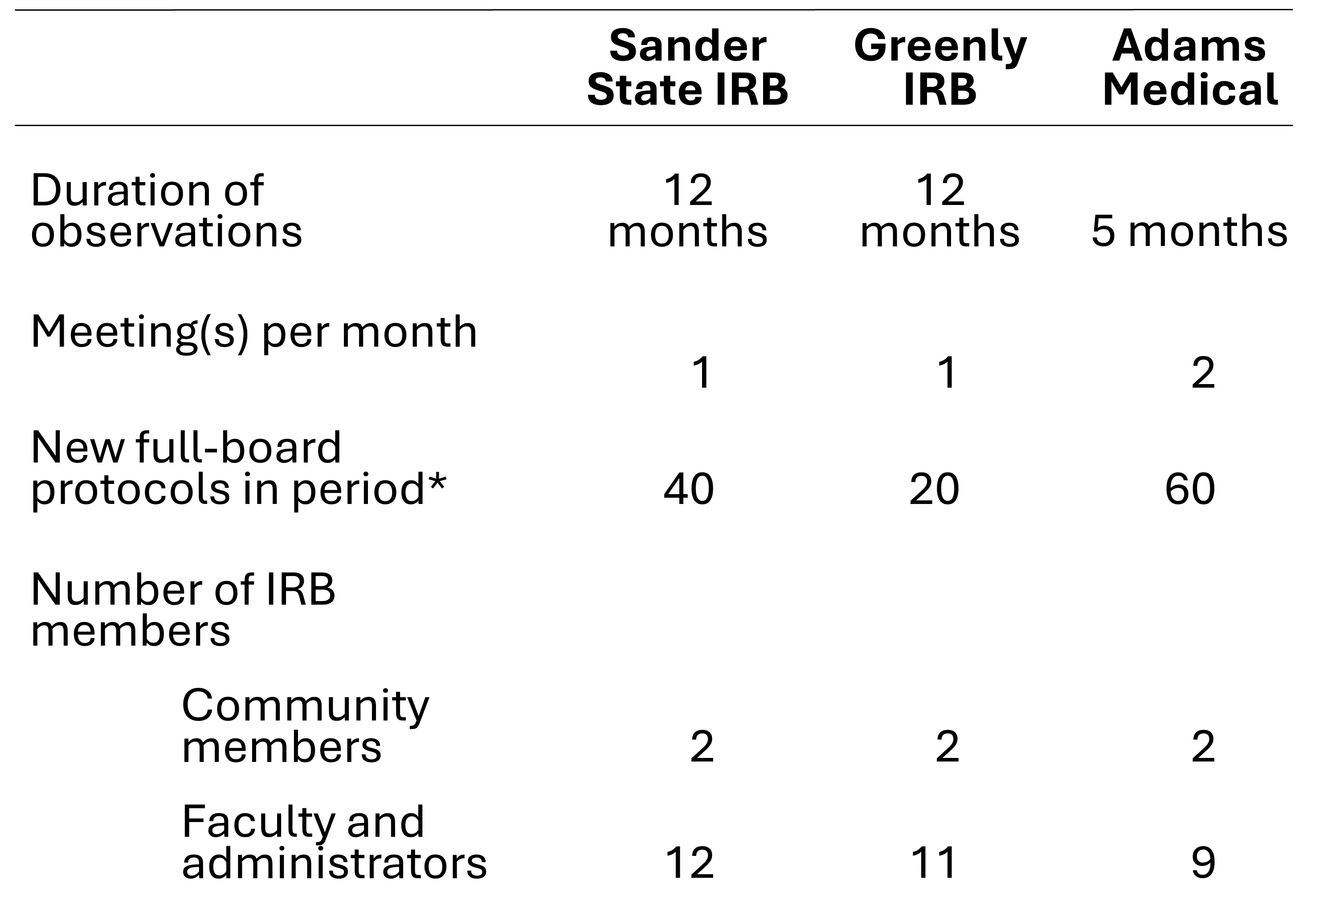
IRBs Observed
Behind Closed Doors: IRBs & the Making of Ethical Research, 2012
IRBs Observed
Table showing information about IRBs observed. The duration of observations was 12 months for the Sander State IRB and Greenly IRB, and 5 months for Adams Medical. The number of meetings per month was 1 for Sander State and Greenly IRBs, and 2 for Adams Medical. The number of new full-board protocols in period was 40 for Sander State IRB, 20 for Greenly IRB, and 60 for Adams Medical. All 3 IRBs had 2 community members as IRB members. The number of faculty and administrators as IRB members was 12 for Sander State IRB, 11 for Greenly IRB, and 9 for Adams Medical.

Slide 4
Goals
Draw attention to quality of decision-making process;
Introduce two empirically-grounded concepts to help IRBs define, assess, and shift IRB decision-making effectiveness;
Provide resources for additional empirically-driven findings.

Slide 5
Major Findings (1 of 7)
Major findings from Behind Closed Doors
Warrants for expertise
Local precedents
Implications
IRB decisions are
Interpreted
Changing
Contradictory

Slide 6
Major Findings (2 of 7)
Major findings from Behind Closed Doors
Concept: Warrants for expertise
Definition:
Warrants are justifications for an opinion.
Whose warrants are / should be taken into account?
Why?
What are the practical implications?
Notes:
Who is an expert on the risks/benefits of a study?
People give “warrants” --- justifications of their views
IMPORTANTLY ERBs have to reach CONSENSUS to act as ERB (“speech-act theory”)
Expert May be scientific –ideally
Expertise may be experiential Just as often personal life
FOR SOCIAL SCIENCES are especially vulnerable because of experiential expertise
THEREFORE, Be the expert IN ERB contexts
Develop personal relationships,
“attend and defend” – go to meetings
Appeal decisions

Slide 7
Major Findings (3 of 7)
Major findings from Behind Closed Doors
Concept: Local precedents
Definition:
Decisions about a new type of study.
Implication:
They guide future decisions about “similar” studies.
Notes:
Why:
Efficiency: - Contentious decisions
Equity – same treatment for different researchers
- no two researchers, no two studies are the same
Consequences FOR SOCIAL SCIENCES:
Inertia – once settled, precedent-setting decisions difficult to change
2. Variability across boards (in institution, across institutions)
Makes collaboration difficult

Slide 8
Major Findings (4 of 7)
Major findings from Behind Closed Doors
  Warrants for expertise
  Local precedents
Implications
IRB decisions are
Interpretations
  Decisions depend on individuals’ differing forms of expertise and on institutions’ context (historical, legal).
  What are the advantages / disadvantages of different processes of deliberation?
Notes:
Decisions are rendered by specific people in institutional TIME and PLACE
Decisions are local --
Unfamiliarity of MEDICAL BOARDS w qualitative methods
What are the advantages / disadvantages of more centralized review; less centralized review
--national , intuitional
--”Devolve” into departments or professions
E.g.,
NEW CATEGORIES MINIMAL RISK
Not exempted BUT EXLUDED RESEARCH – can

Slide 9
Major Findings (5 of 7)
Paradox of risk for social science research
Major findings from Behind Closed Doors
  Warrants for expertise
  Local precedents
Implications
IRB decisions are
  Interpretations
  Changing
  Interpretations, as well as rules, change over time, across institution.
Notes:
1. For 1960s funders, there was EXPLICIT effort to avoid topics
“religion, sex, politics”
In addition to concerns about privacy, confidentiality
EXAMPLE: APA
2. Risk was research was politically risky—socially, interactively
Discussing sex may have changed
BUT meaning of risk has shifted
Politically hot-button issues: Research on “trauma”
FOR SOCIAL SCIENCES POLITICAL risk is important

Slide 10
Major Findings (6 of 7)
Major findings from Behind Closed Doors
Warrants for expertise
Local precedents
Implications
IRB decisions are
Interpreted
Changing
Contradictory
  Multisite research; changes in staff, membership
Notes:
TWO institutions that consider risk; they give contradictory incentives to researchers’ definition of risk:
1. ETHICS REVIEW
Ethics review spread as a condition of PUBLIC FUNDING
Why LIABILTY – Therefore, National science funders require ethics review
Balance “risk and benefit”
In recent months, US created new categories:
EXCLUDED research
2. FUNDING REVIEW
Important research is also coded as “risky” – unprecedented, unknown outcomes.
“Originality” in the social sciences (Lamont; Geutzkow) THERE are no precedents

Slide 11
Major Findings (7 of 7)
Major findings from Behind Closed Doors
Warrants for expertise
Local precedents
Implications
IRB decisions are
Interpretations
Changing
Contradictory

Slide 12
Goals 2
Draw attention to quality of decision-making process;
Introduce two empirically-grounded concepts to help IRBs define, measure & assess IRB decision-making effectiveness;
Provide resources for additional empirically-driven findings.

Slide 13
Additional Resources
Stark, Laura. “Chapter 11: IRBs and the Problem of Local Precedents.” In Human Subjects Research Regulation, edited by I. Glenn Cohen and Holly Fernandez Lynch, 173–86. Cambridge, MA: MIT Press, 2014.
Stark, Laura. “Reading Trust between the Lines: ‘Housekeeping Work’ and Inequality in Human-Subjects Review.” Cambridge Quarterly of Human-Subjects Protections, 2013.
Stark, Laura. “The Language of Ethics: How Ethics Review Creates Inequalities for Language Minorities in Research.” In The Ethics Rupture: Exploring Alternatives to Formal Research-Ethics Review, edited by Hoonaard and Hamilton, 91–105. Toronto: University of Toronto Press, 2016.
Stark, Laura. “Protections for Human Subjects in Research: Old Models, New Needs?” MIT Case Studies in Social and Ethical Responsibilities of Computing, Winter 2022 (January 24, 2022).

Slide 14
Closing Slide
Quality of IRB deliberations:
Defining, measuring & ensuring effectiveness
OHRP/OCLIP
17 Oct 2024
Laura Stark, Ph.D.
Vanderbilt University
http://www.laura-stark.com/

