Slide 1
Infection Prevention and Control during a Pandemic Outbreak
Arjun Srinivasan, CAPT USPHS
Deputy Director for Program Improvement
Division of Healthcare Quality Promotion
Centers for Disease Control and Prevention
September 2022

Slide 2


Pandemic challenges unraveled U.S. progress on AR.
The data:
Alarming increases in resistant infections starting during hospitalization—deaths and infections increasing at least 15% each (2019 to 2020)
After years of steady reductions in healthcare-associated infections (HAIs), U.S. hospitals saw significantly higher rates for four out of six types of HAIs in 2020¹
Acute care hospitals also saw more Candida auris cases, including in COVID-19 units²
ESBL-producing Enterobacterales ( 32%)
Vancomycin-resistant Enterococcus ( 14%)
Multidrug-resistant P. aeruginosa ( 32%)
Methicillin-resistant Staphylococcus aureus ( 13%)
Carbapenem-resistant Acinetobacter ( 78%)
Antifungal-resistant Candida auris ( 60%)
Carbapenem-resistant Enterobacterales ( 35%)
Antifungal-resistant Candida ( 26%)
1. Weiner-Lastinger, L.M., et al. (2022). doi:10.1017/ice.2021.362
2. Prestel, C., et al. (2021). doi:10.15585/mmwr. mm7002e3
Notes:
Citations:
1. Weiner-Lastinger, L.M., Pattabiraman, V., Konnor, R.Y., Patel, P.R., Wong, E., Xu, S.Y., Smith, B., Edwards, J.R., & Dudeck, M.A. (2022). The impact of coronavirus disease 2019 (COVID-19) on healthcare-associated infections in 2020: A summary of data reported to the National Healthcare Safety Network. Infection Control & Hospital Epidemiology, 43(1), 12-25. doi:10.1017/ice.2021.362
2. Prestel, C., Anderson, E., Forsberg, K, Lyman, M, de Perio, M.A., Kuhar, D., Edwards, K., Rivera, M., Shugart, A, Walters, M., & Dotson, N.Q. (2021). Candida auris outbreak in a COVID-19 specialty care unit — Florida, July–August 2020. MMWR Morbidity and Mortality Weekly Report, 70, 56–57. doi:10.15585/mmwr. mm7002e3

Slide 3
COVID-19 demonstrated the many AR challenges pandemics pose.
Sicker inpatient population
Extended lengths of stay
Increased device use, such as catheters and ventilators
More transfers between hospitals and nursing homes, making residents more vulnerable
Infrastructure issues resulted in infection prevention and control breakdowns:
PPE, disinfectant and laboratory supply challenges
Staffing shortages due to illness and burnout
Overburdened and overcrowded facilities
More HAIs
More AR
More deaths

Slide 4
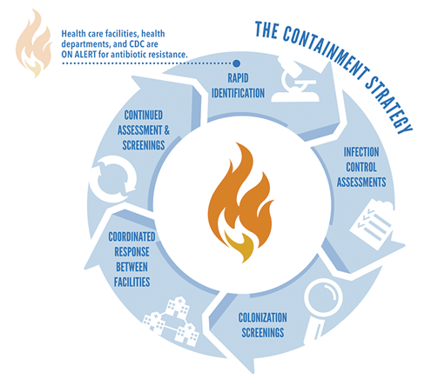
COVID-19 also demonstrated the primacy of infection prevention and control in pandemic response.
Infection prevention and control is the first tool available in any response
Keep it out, detect it fast, stop the spread.
Rapid identification of suspect cases
Immediate isolation and referral for testing
Adherence to IPC practices
Safe clinical management, supporting staff

Slide 5





We are better positioned now than pre-pandemic: Healthcare-public health collaboration for IPC
Stronger connections between healthcare + public health via state and local HAI/AR programs.
State HAI/AR programs have developed expertise in supporting facilities, especially nursing homes, with infection prevention and control.
For example, Infection Control Assessment & Responses:
State programs did more than 58K infection prevention consultations/responses during the pandemic (Jan. 2020-July 2021)
This supportive work is continuing via $500 million in nursing home strike funding to states
Assessments During the Pandemic Identified Infection Control Gaps
From January 2020 through July 2021:
HAI/AR programs conducted
Using CDC’s Infection Control Assessment and Response tools in
58,807
Consultations
8,827
13,185
Most assessments in nursing homes or assisted living facilities
Assessments reduced the spread of threats
in response to potential COVID-19 healthcare outbreaks
Online assessments
Remote assessments

Slide 6
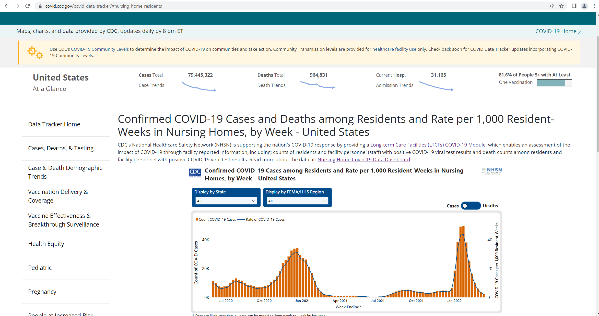

We are better positioned now than pre-pandemic: Data for action
Soon after the start of the pandemic, CDC’s National Healthcare Safety Network stood up COVID-19 reporting modules for facilities across the healthcare continuum: hospitals, nursing homes, dialysis facilities.
That data has been used in real time to:
Direct PPE supplies to facilities with needs
Identify facilities with large outbreaks for targeted outreach and support
Identify facilities with low vaccination rates for targeted outreach and support
Assess the effectiveness of infection control recommendations
Assess the effectiveness of vaccines, including boosters
https://covid.cdc.gov/covid-data-tracker/#vaccinations-nursing-homes
https://covid.cdc.gov/covid-data-tracker/#nursing-home-residents

Slide 7
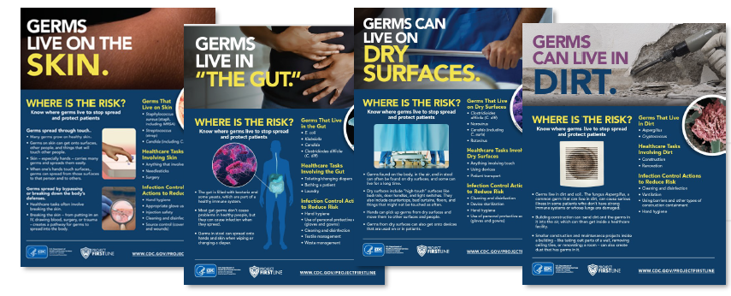
We are better positioned now than pre-pandemic: Expanded and just-in-time training for all HCWs
Healthcare personnel needed training throughout the pandemic:
Wanted basic refresher training on infection prevention, e.g., isolation precautions, and using PPE
Infection prevention staff spent significant time training, limiting their time on other important work
To fill this gap, CDC launched Project Firstline:
A new program intended to provide tailored education to ALL healthcare personnel and designed to incorporate best practices in adult learning and health equity.

Slide 8
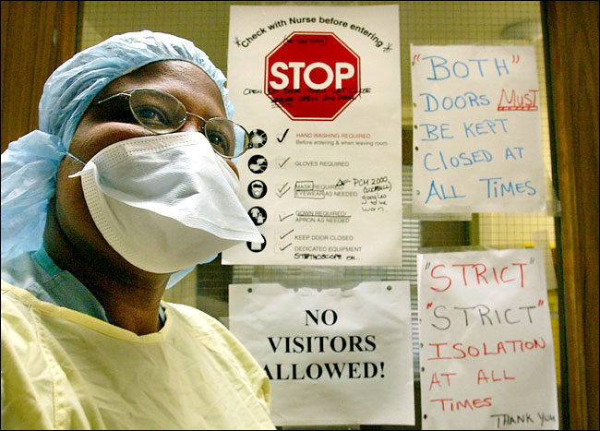
Gaps still exist in the “new normal”
The funding for many of our gains is time limited.
Without continued funding support, e.g. for state HAI/AR programs, we will lose the valuable infrastructure that’s helped us respond to COVID-19.
There were staffing challenges in many facilities before the pandemic.
In addition to having too few, the healthcare workforce is now exhausted, burned out and demoralized
We must support healthcare personnel as they struggle to return to a new normal
What are structural improvements that will make a meaningful difference (“We don’t need more muffins and pizza”)?
What are strategies that will attract more people to healthcare, especially nursing and nursing assistants?
There are also other innovations that could transform our abilities to address AR threats in future pandemics.

Slide 9
Influenza Pandemic Response Components
NPI Interventions to prevent disease transmission
Provide quality medical care
Maintain essential services/ response activities
Treatment /prophylaxis
Vaccination
Time
NPI (nonpharmaceutical intervention)
Notes:
Primary prevention of flu will prevent flu and secondary infections; Until we have primary, secondary prevention will include NPIs, IPC will tackle AR and flu pandemic issue

Slide 10
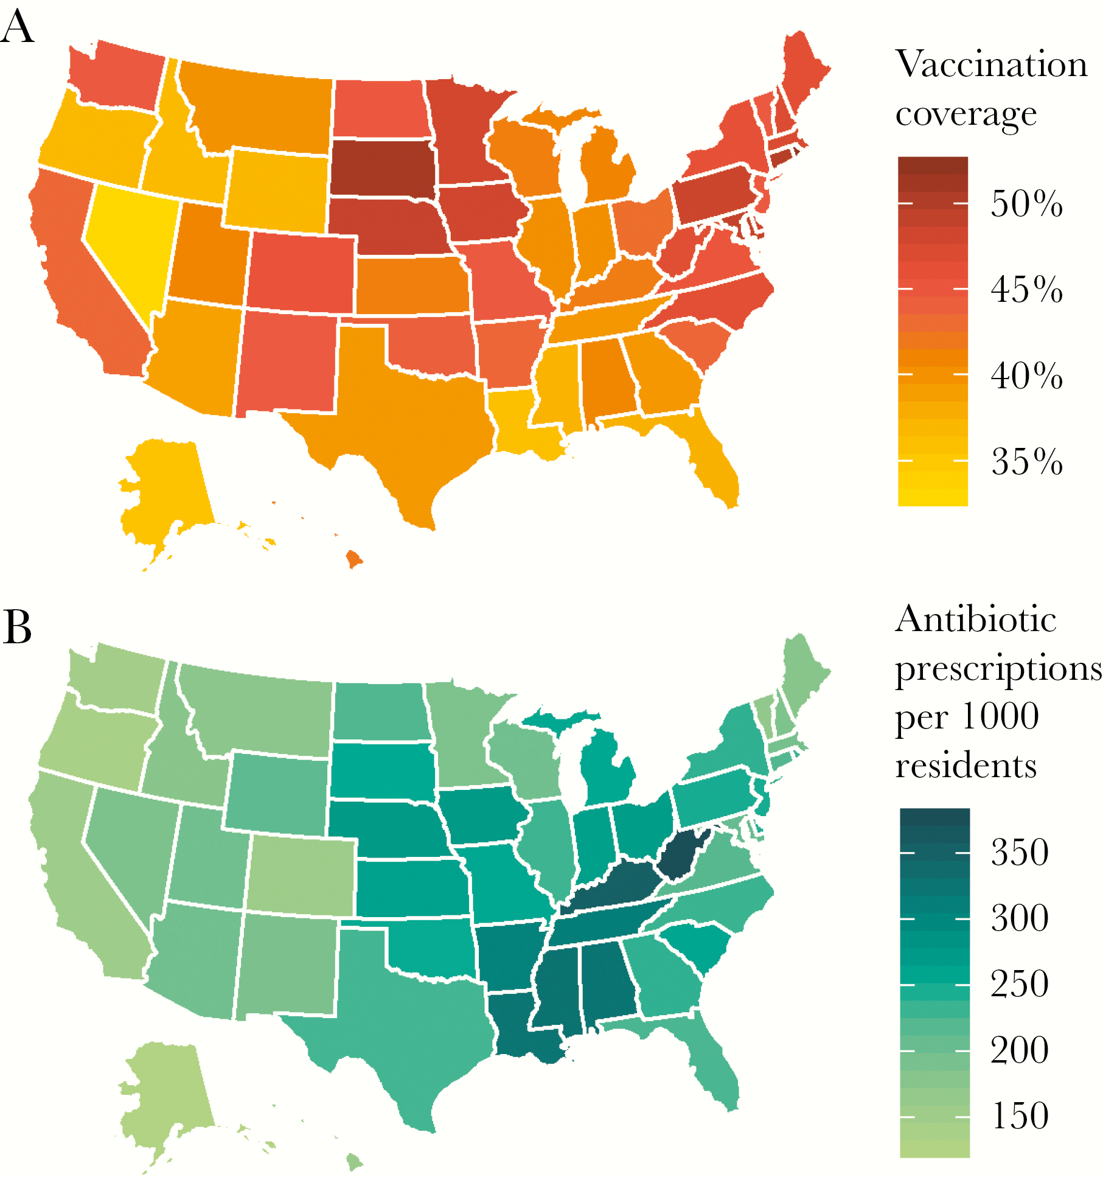
Invest in innovations now to prevent infections: Vaccines.
Increases in influenza vaccination associated with significant reductions in antibiotic prescribing
Vaccines hold great promise as a key implement in the toolkit to reduce AR
Real-world evidence already exists for vaccines directed against community-associated pathogens
More work needed to develop vaccines against healthcare-associated pathogens
Only have 3 vaccines licensed for the 18 AR threats (Strep pneumo, Salmonella Typhi, TB)
Vaccines can reduce antibiotic use and potentially reduce antibiotic pressure
To realize full potential, need better coverage for existing vaccines (influenza, pneumococcus, rotavirus, others)
Need to understand effect of COVID-19 vaccines
Critical to have systems in place to track the impact of vaccines on AR and antibiotic use in populations
Klein E., et al. (2020). https://doi.org/10.1093/ofid/ofaa223.
Notes:
Increases in influenza vaccination associated with significant reductions in antibiotic prescribing
10% increase in the influenza vaccination rate associated with 6.5% decrease in antibiotic use (14.2 fewer antibiotic prescriptions per 1000 individuals).
Increased coverage reduced prescribing rates the most in the pediatric population.
Results strongest for the drugs most likely prescribed for upper respiratory tract infections, including penicillins, macrolides, and cephalosporins

Slide 11
Invest in innovations now to prevent infections: Decolonizing agents.
Colonization drives transmission of resistant organisms in healthcare settings. We need more research and development for agents that reduce or eliminate the burden of colonizing pathogens to:
Prevent recurrence and do more than “decontaminate,” such as protecting and/or restoring the microbiome
Reduce pathogen burden (load) and/or eliminate pathogens completely, even better if it has a targeted application (body site, pathogen). Products that will not drive or increase AR should be prioritized.
Benefit individuals (the “source”) and populations
CRE Decolonization Prevents Infections from Known Carriers in All U.S. Long Term Acute Care Hospitals*
*Damon Toth, unpublished adaptation of model published in Toth et al. Clinical Infectious Diseases 2021;72(S1):S34–41

Slide 12
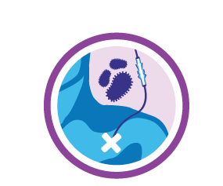
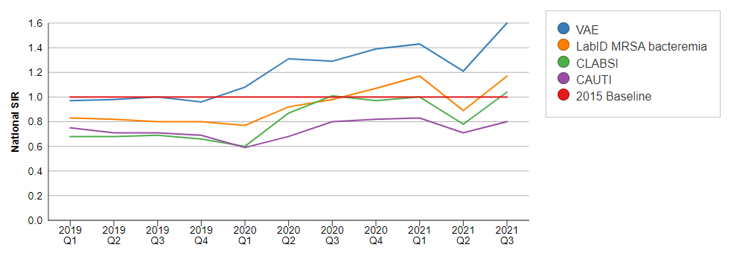
Invest in innovations now to prevent infections: Better device technologies.
Device safety currently relies almost entirely on HCP technique; any breach can lead to infections.
Device-associated infections are common and are often caused by AR pathogens—not only harming that patient but creating a reservoir for spread to others.
COVID-19 resulted in increased device use and we would expect the same in any future pandemic (see figure).
We need better device technologies to support safer patient care:
Devices that are easier to maintain
Devices that are resistant to microbial colonization
CDC - HAI Data

Slide 13
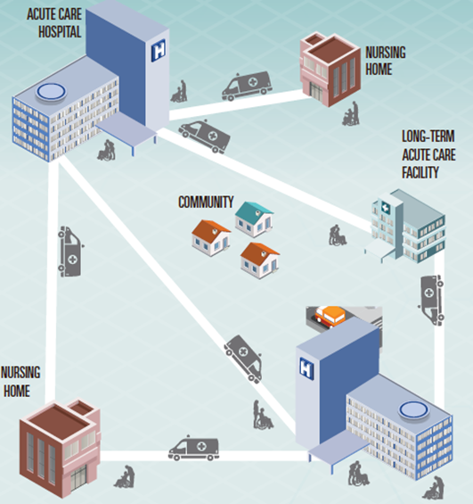
Invest in innovations now to prevent infections: Prevention-focused policies & practices.
Healthcare system preparedness
Tiered facility prioritization
Remote and on-site support, including telehealth
Collaboration with health departments and QIOs
Convening external partners regularly
Building on years of CDC, CMS collaboration
Post-acute care gaps for vulnerable populations
>15,400 long-term care facilities in the U.S.
~1.3 million residents each day
~29,000 assisted-living communities with ~1 million total licensed beds and >800,000 residents
Health equity and access
Tailored approaches
Access to quality care
Emerging Diseases Follow a Consistent Pattern

Slide 14
What’s Needed
Sustainability of critical AR programs that turn data into prevention:
HAI/AR Programs
National Healthcare Safety Network (NHSN)
Project Firstline (PFL)
Continued and expanded data collection from nursing homes and outpatient facilities
Sustained efforts to ensure surge capacity for PPE supplies
Innovations to address gaps that emerged during COVID-19:
Healthcare personnel support and staffing
Vaccines
Decolonizing agents
Better device technologies

Slide 15
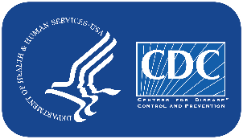
Thank you
@CDC_AR
Join our email distribution list
—search “Antibiotic Resistance” at bit.ly/CDC-email-listserv
For more information, contact CDC 1-800-CDC-INFO (232-4636) TTY: 1-888-232-6348 www.cdc.gov
The findings and conclusions in this report are those of the authors and do not necessarily represent the official position of the Centers for Disease Control and Prevention.

