Slide 1

PACCARB
Infection Control and Challenges from Frontline Healthcare Providers
Lilian Abbo, M.D, FIDSA
Professor of Infectious Diseases
University of Miami
Associate CMO Infectious Diseases
Jackson Health System
September 12-13, 2022

Slide 2
The situation
Pandemic caused by a highly transmissible respiratory virus and MDR bacteria and fungal pathogens
Novel infections and unclear mechanisms of transmission vs Droplet and Contact Precautions
Global supply chain interruptions have led to
Supply chain of PPE (N95 boxes disappear from Omnicells)
Shortage of disinfectants and hand sanitizer missing from the units
Scarcity of antimicrobials: stewardship team implemented more restrictions to stretch access to all patients
Limited oral agents to transition patients from IV to PO leading to more CLABSIs
cancel elective surgeries; transplant, trauma are 24/7 we can’t stop

Slide 3
Keys to Success:
Plan, Prepare, Adapt
Operations
Clinical
People
Products
Places
Triage
Test
Trace
Treat
Vaccinate
Notes:
BE PROACTIVE NOT REACTIVE

Slide 4

Administration*
Chief Operating Officer
Chief Executive Officer
Chief Physician Executive
Chief Strategic Officer
Chief Financial Officer
VP Marketing Communications
VP Human Resources
Clinical*
Chief Infection Control
Director Infection Control
Chief Emergency Planning
Corporate Director Pharmacy
Employee HR
Information Technology
Environment controls
Laboratory testing
Community partnerships
Patient care
Procurement
Pandemic Core* Health System Response Leadership Team
Infection Prevention
Engineering/ Biomed
Public Safety
Clinical Trials
OR, ICU ED, Med/ Surg
Internal
External
Stewardship
new platforms
Dashboards
Telemed
Apps, websites
Protocols
COVID Protocols
PPE Education, distribution
Emotional Support
Redeploy staff
Testing sites
Dep of Health, FEMA, HHS
Hospitals
Employee Health
EVS
Treatment protocols
System
Leaders
CEOs
CNOs
COOs
Physicians and CMOs
Communication
CFOs
Pharmacy
Stewardship Protocols
Literature up to date
ICU/ OR inventory
Tiers/ workflows
Infection Control
Mandatory masks
Visitors/ restriction
Isolation
PPE guidelines
Donations, kindness
supply chain
Transplant
Chief Informatics
* In parallel: close collaboration and communication with Miami Dade County Mayor and Florida Governor, Secretary of Health and Emergency Management for the State

Slide 5
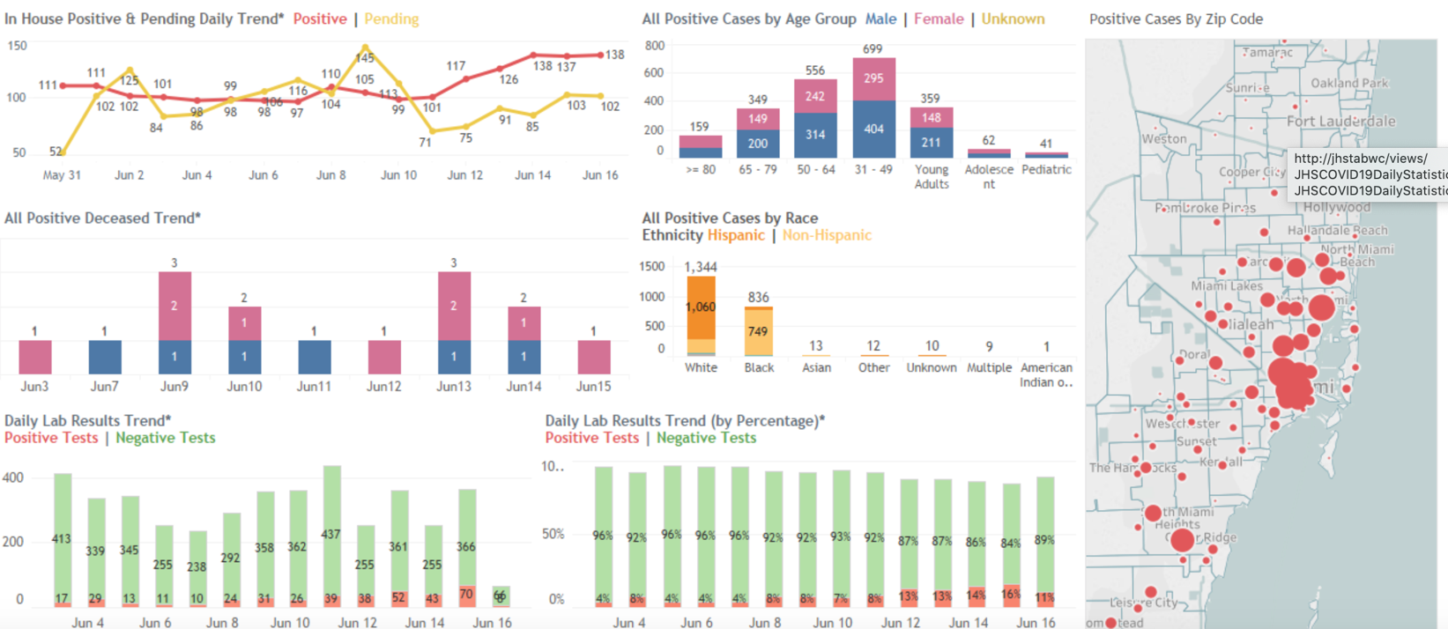



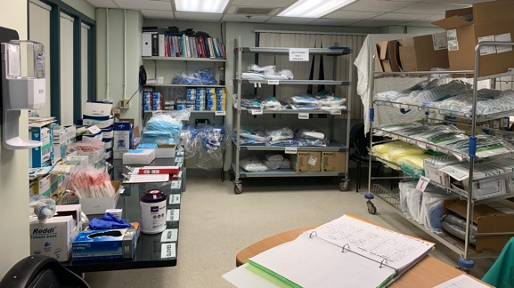
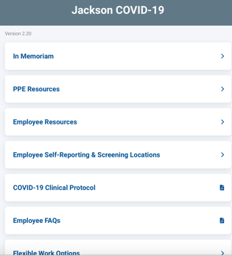
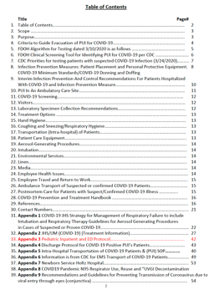

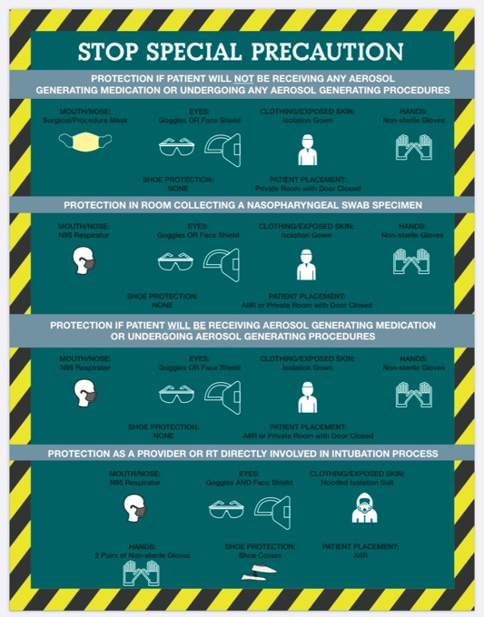
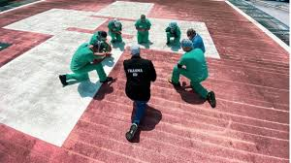
Real Time Reliable Dashboards
Community Partners
Collaborate with other
health systems to avoid surges
(not enough isolation rooms or providers!)
Standardized Protocols
PPE
Distribution
Signage and Education!
Support, Wellness, Mental Health

Slide 6
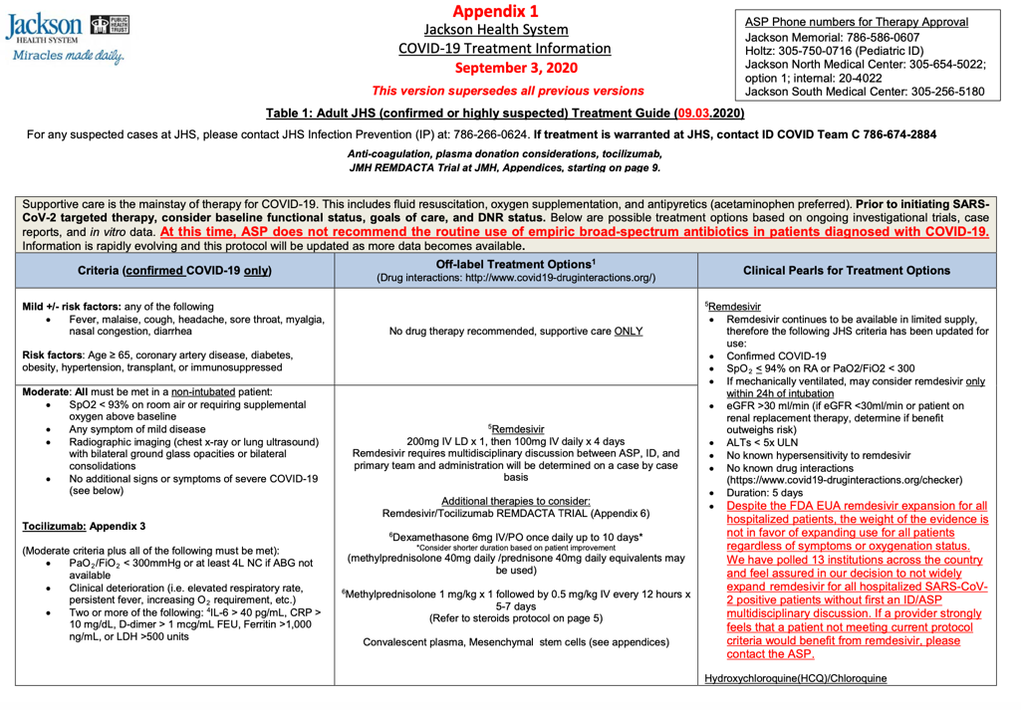
Pharmacy Inventory Dashboards for COVID and Critical Medications
Drug Dose Supply x 2 weeks
Critical Low (<10 patients)
Low (10-50 patients)
Monitoring Closely (>50 patients)
IV to PO options limited
Home care not an option for drugs under FDA EUA
Sending patients to ER for treatment!

Slide 7
ICU
To avoid entering rooms multiple times the staff decides to use extended tubing and place the IV pumps on the hallways
Increase in C.auris infections
Tubing touching the floors, CLABSIs
EVS staff not entering the rooms to clean as frequently
Nutrition avoids the units and leaving food carts on the hallways
Patients in prone position to improve ventilation / difficult to perform oral care/ limited mobility increasing pressure ulcers and HAP, CAUTIs
ICUs in some floors are open/ multipatient unit / curtains
Nurses, PCTs, respiratory therapists: scared, tired, short- staffed
RNs clean the environment/ take trash and feeding patients

Slide 8
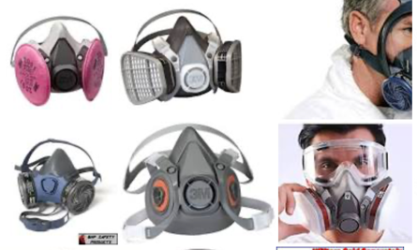
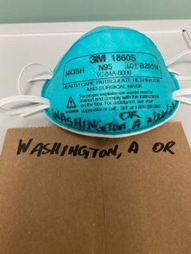
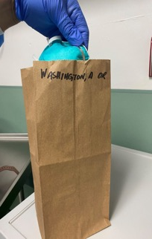
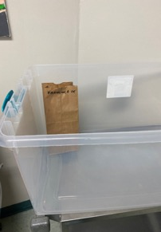
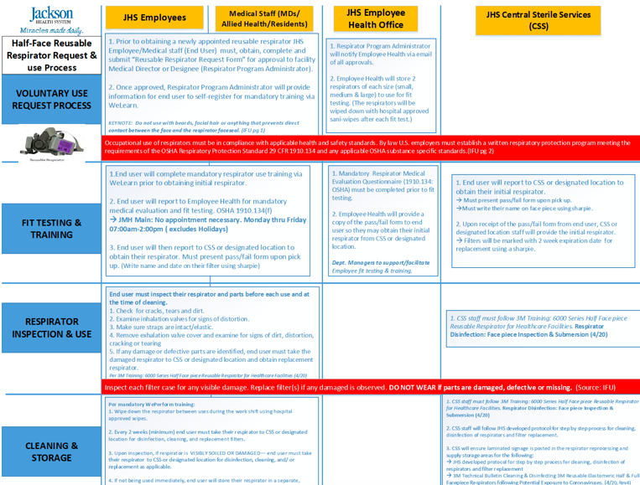

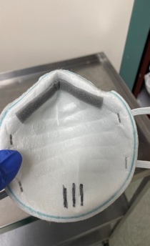
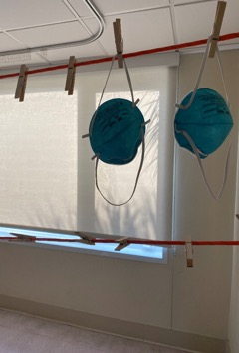
PPE Burn Rates and Supply
https://www.nebraskamed.com/sites/default/files/documents/covid-19/n-95-decon-process.pdf

Slide 9
Diagnostics
D/c Isolaton placement
Needs for low-cost point of care rapid diagnostics to determine if a patient has a a viral infection: testing every admitted patient
How long do we isolate? When are you not contagious?
Need for MDRO bedside lateral flow assays (Not FDA approved, available in Europe).
Supply chain – limited reagents to do our standard cepheid/ biofire PCRs
(Tiers based on TAT for testing platforms: OR, transplant, trauma, Med surg or behavioral; Jails)
C.auris testing (diagnostics) is a send out to the State DOH and they are overwhelmed with the pandemic so everything from Miami is being sent to Minnesota.. TAT is 2 weeks (snow strorm)
Our hospital decides to get our in-house test (have to do validation as the test is not commercially available) takes another 8 weeks and the vendor has marked up all the prices (no regulation)

Slide 10
ucc behavioral EMPLOYee health & corrections
Urgent care Centers don’t have isolation rooms (create a process), point of care test and triage for outpatient treatment (expand Telehealth)
Behavioral Health: patients live in open rooms/ dining halls, difficult to ensure hand hygiene/ mask use on patients (rapid transmission). Protocols to test and isolate on admission
Patient/ employee Contact Tracing is difficult (PPE for employees but they are getting infected in the community/ home)
Jails: PPE compliance; cleaning environment; new arrests testing/ isolation) vaccines?
isolate 60 inmates in 1 cell – quarantine exposures

Slide 11
Visitors
We need to preserve PPE and avoid infections in healthcare workers
Limit number of providers entering the rooms unless medically necessary (patients are lonely and worried)
Patients can’t communicate with families (forgot phone chargers at home or the cord is too short to connect to the head of the ICU bed) our beds do not have USB ports!

Slide 12
CHALLENGES
C.auris patients – none of the other hospitals or nursing homes are accepting transfers and is increasing our LOS over 120 days! When we need beds
Contact isolation for the CREs/ C.auris – we can’t keep 1:1 patient to nurse ratios, dedicated equipment and cleaning is difficult as rooms are semi-private
Frontline Healthcare workers calling out sick or to care for their family members; schools, daycares and elderly care centers are closed – when can they return to work? Infectious?
Getting requests as ID expert to speak to the media (bilingual) multiple times a day → need to educate the public vs. manage patients, providers, report to C suite
Personal life/ family responsibilities, boundaries and our own mental health

Slide 13
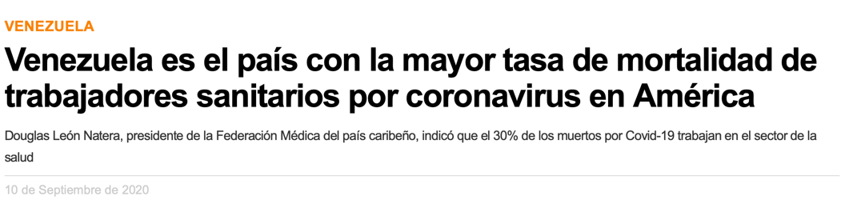

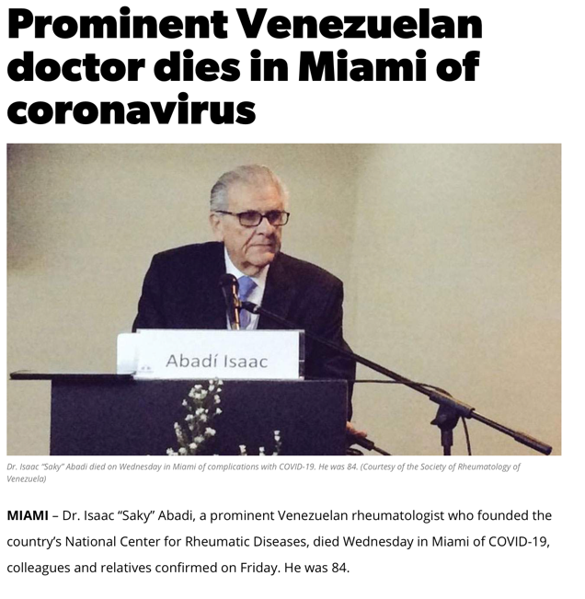
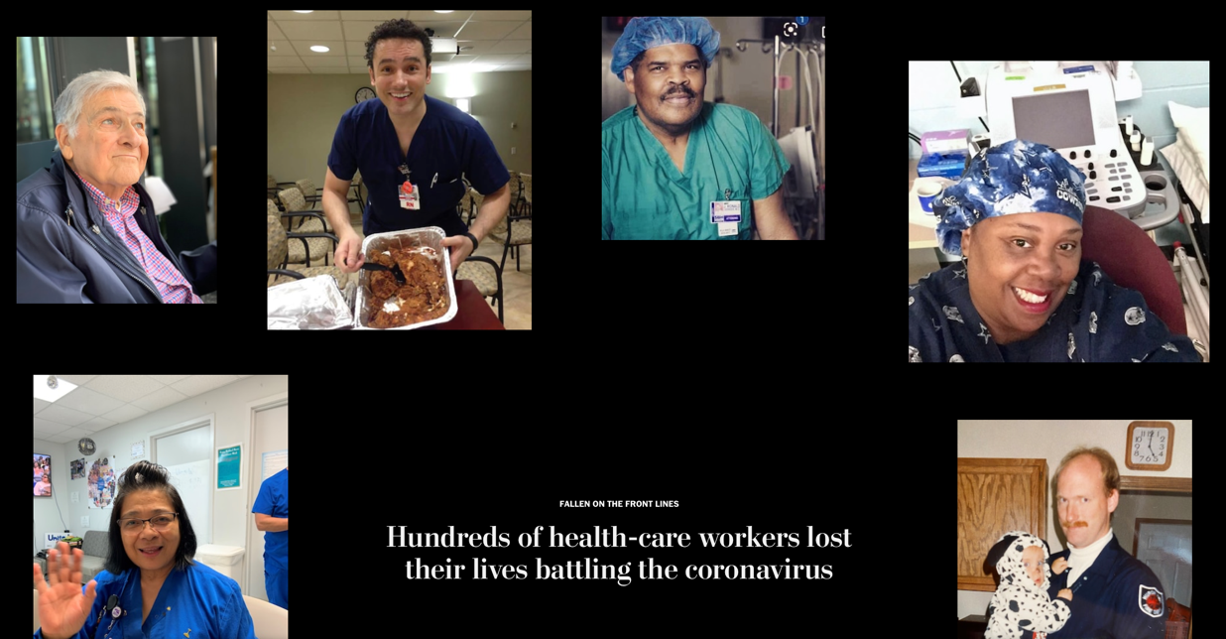
The Washington Post, June 17 2020

Slide 14
we need global solutions
OPPORTUNITIES FOR HHS
  Timely cost-effective evidenced based decisions ( national and/or international data)
  Communication with frontline stakeholders (bidirectional) remove barriers and opportunities
  De-centralization of rapid diagnostic testing vs. sending tests to DOH/ CDC
  Allocation of staff, resources and reimbursement strategies for home-care models (monoclonals; therapeutics; clinical monitoring) to avoid crowding Emergency Departments and UCCs.
  Ramp up technology in healthcare: AI, blockchain, face recognition for testing, real time data dashboards, social determinants of health and avoid further disparities in access and type of care
  Goals of care, advance directives

