Slide 1
Evolutionarily-Informed Community Surveillance of AMR
Rachel Whitaker and Helen Nguyen

Slide 2
Pandemic Lessons
Context matters! Social-cultural and political conditions impact evolution of host-associated microbes, infectious disease emergence and control.
Local dynamics have global consequences
Convergent, team science is essential to meet our biggest challenges.

Slide 3
Antibiotic Resistance Is an Evolutionary Problem
Mutation
Selection
Antibiotic Resistance
Transmission

Slide 4

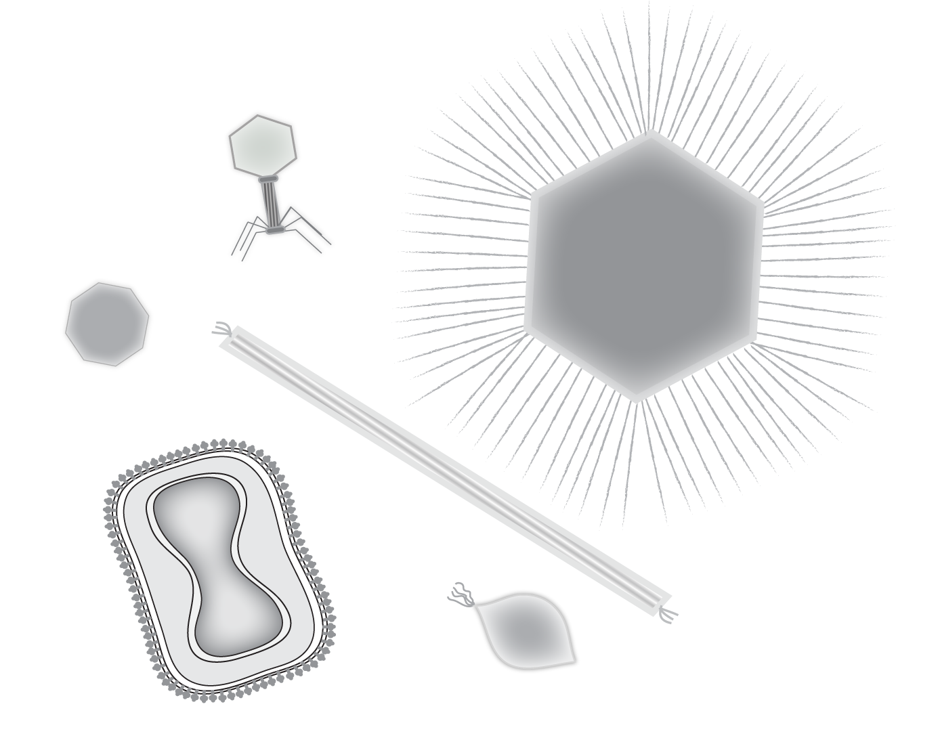

Evolution is infectious: Plasmids are fundamental agents of rapid evolutionary change

Slide 5
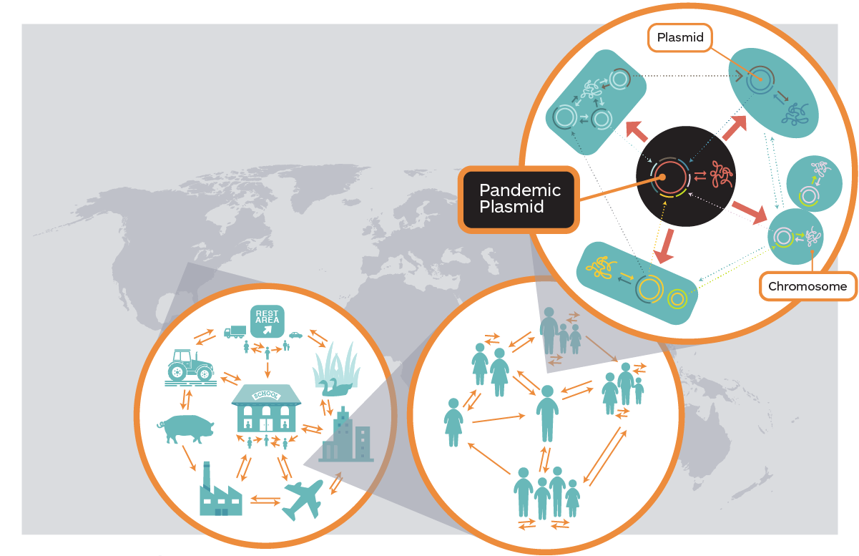
Multi-Scale Microbial Networks of Antibiotic Resistance Transmission

Slide 6
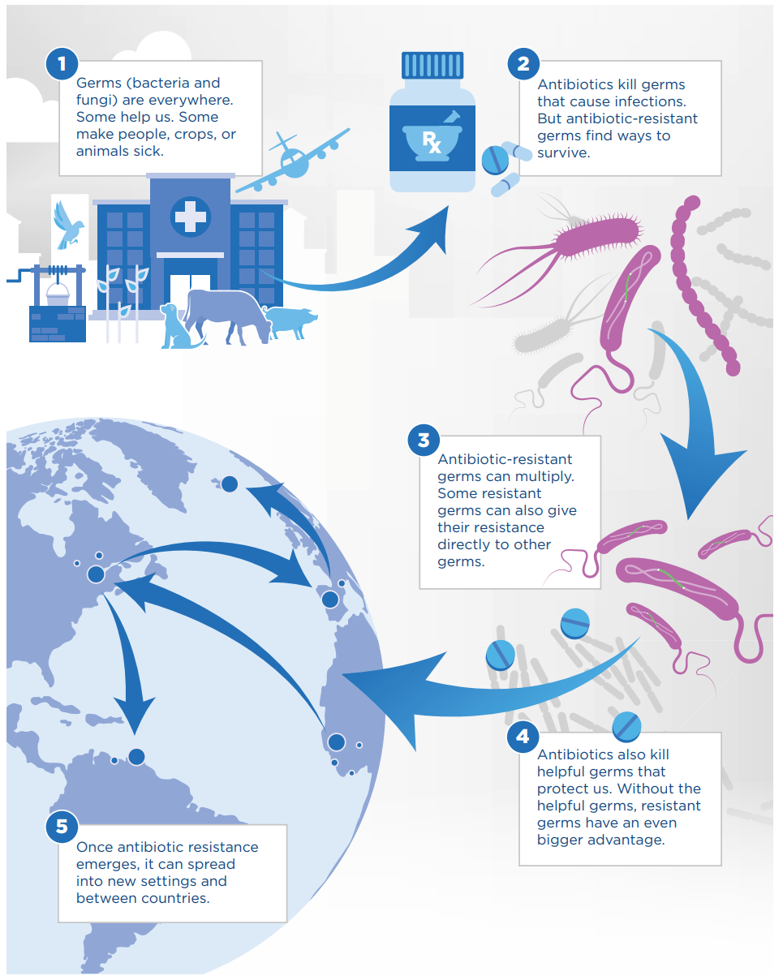
Once AR is in the clinic it is too late.

Slide 7
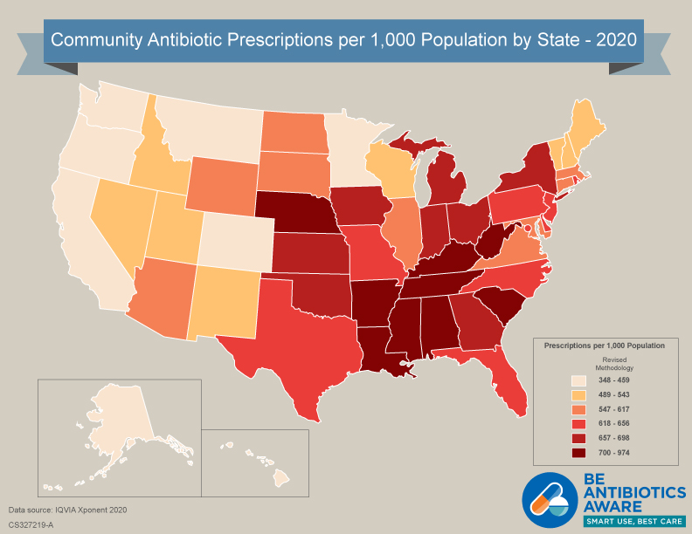
What scale for surveillance?

Slide 8
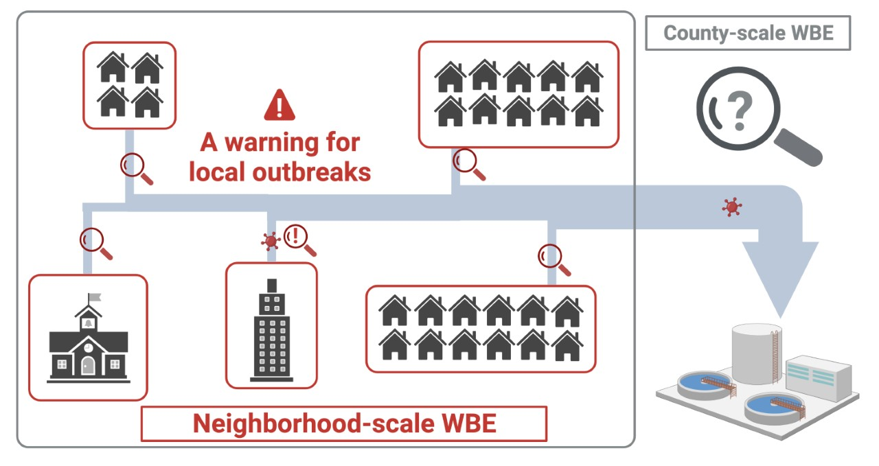
Monitoring every human being on earth is impractical. We should monitor what we release and around us
Tens of thousands to millions people

Slide 9
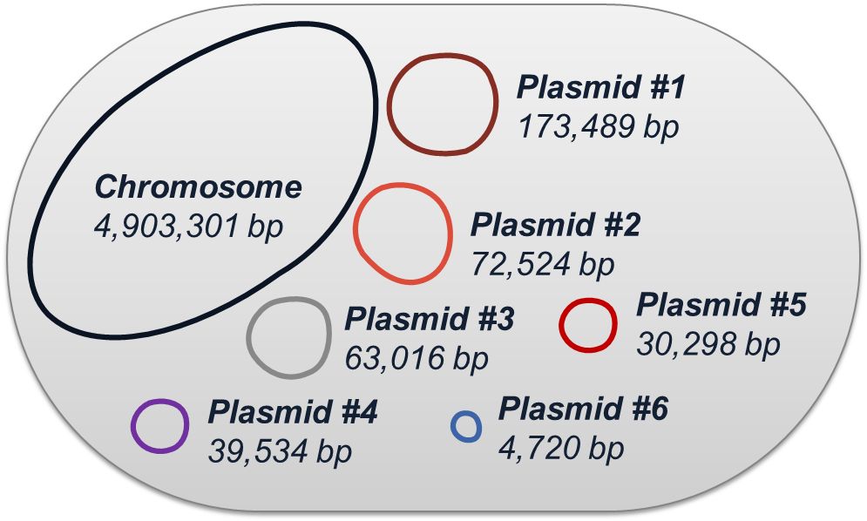
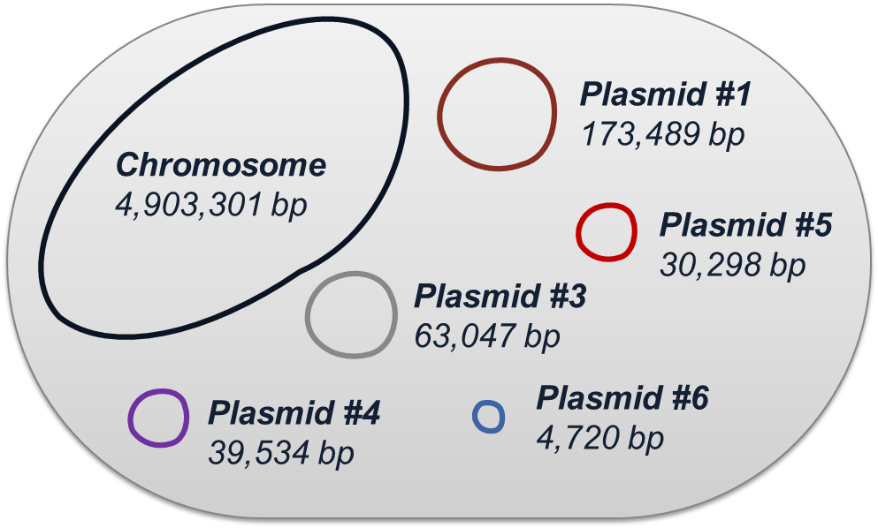
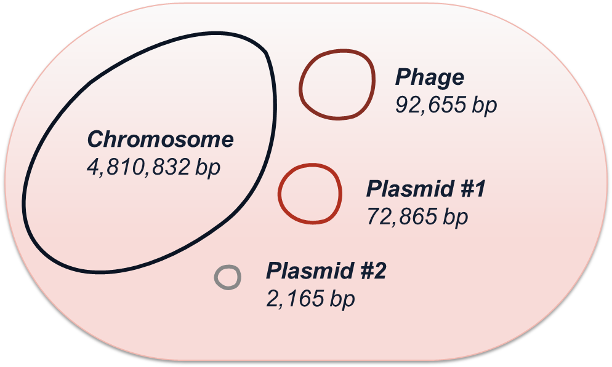
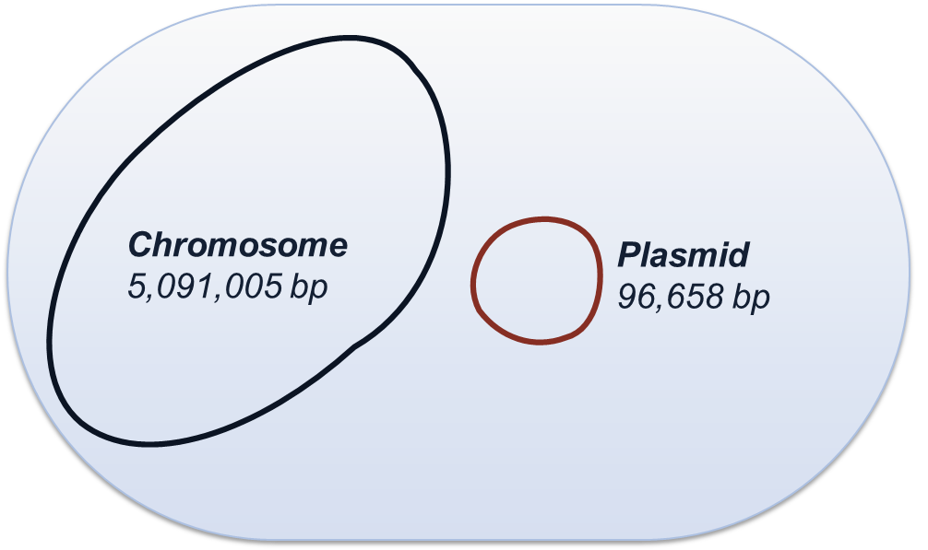
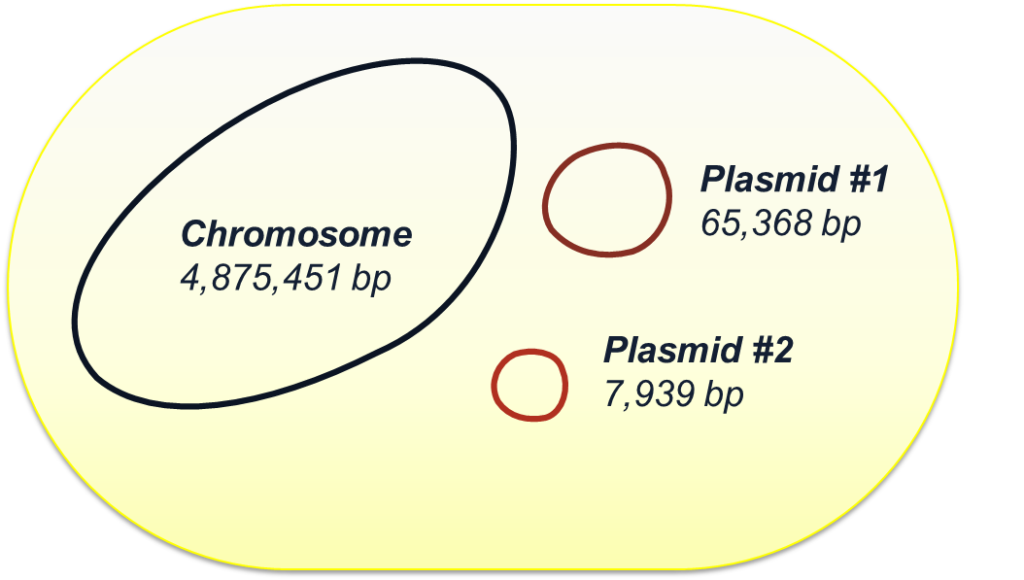
Tracking emergence of ARG using the complete, composite genome
Site 1 pork plant - #1 (ST 23):
Site 1 pork plant - #2 (ST 23):
Site 5 Urbana - #1 (novel ST):
Site 9 Rantoul - #1 (ST 219):
Site 9 Rantoul - #2 (ST 10):

Slide 10
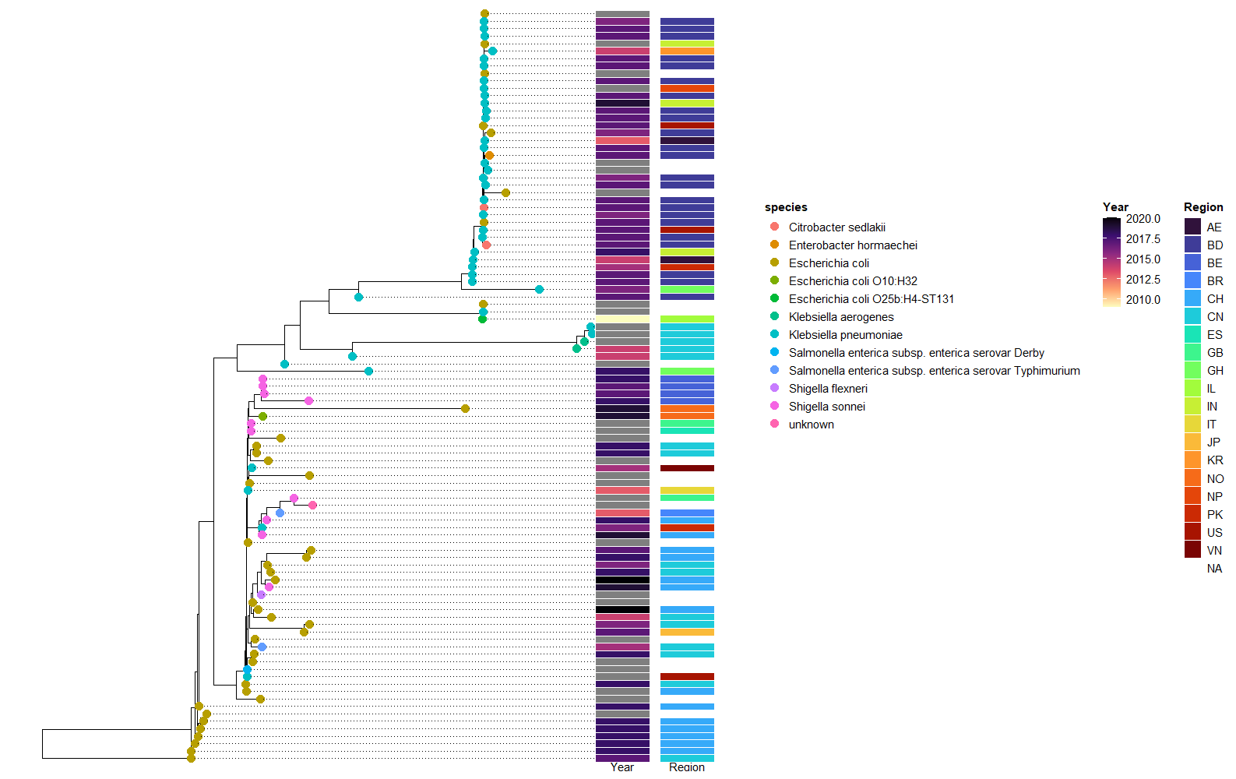
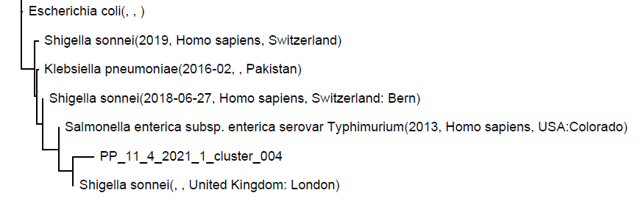
A plasmid from the pork plant sample shares common sequences with plasmids of other enteric bacteria

Slide 11
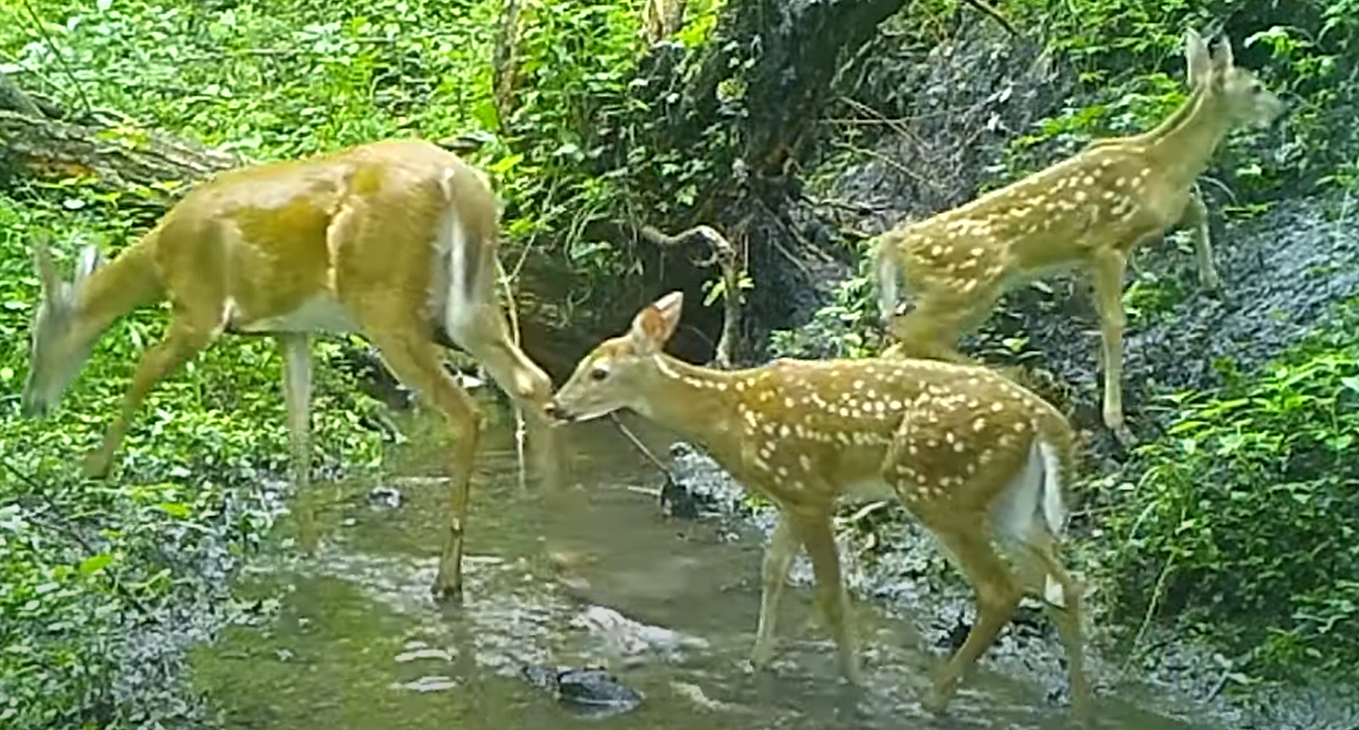
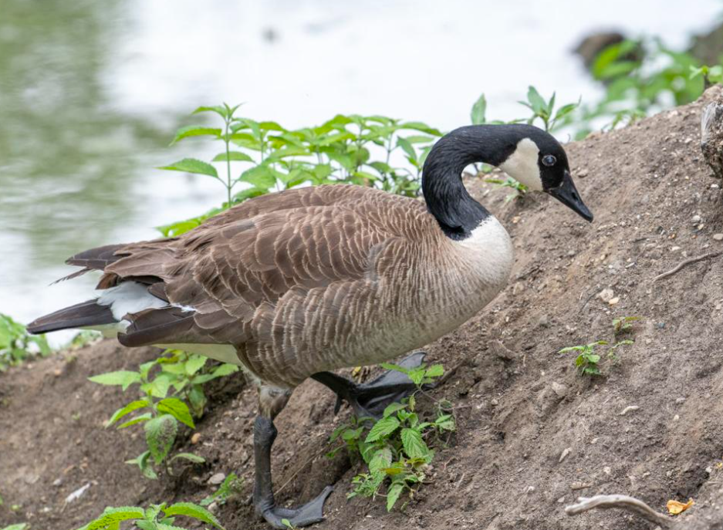
Target the carrier of resistance before it reaches epidemic proportions.
Resistance emergence should be monitored and predicted in the interdependent multi-scale networks

Slide 12





Acknowledgements:
Students and Postdocs
  Yuqing Mao
  Isaiah Goertz
  Dr. Ken Ringwald
  Dr. Giulia Orazi
Infection Genomics for One Health
Rachel Whitaker
  Microbiology
Rebecca Smith
  Epidemiology
Ellen Moodie
  Anthropology
Mohammed El-Kebir
  Computer Science
Katy Heath
  Mutualism Evolution
Zoi Rapti
  Mathematical Modeling
Tandy Warnow
  Phylogenetics
Chris Brooke
  Virus Evolution
Helen Nguyen
  Environmental Engineering

Slide 13
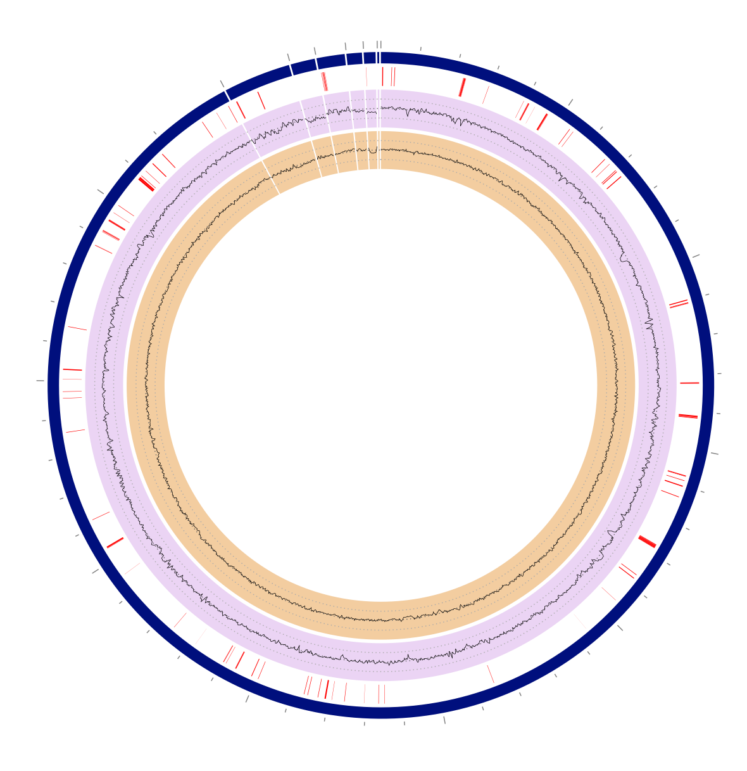
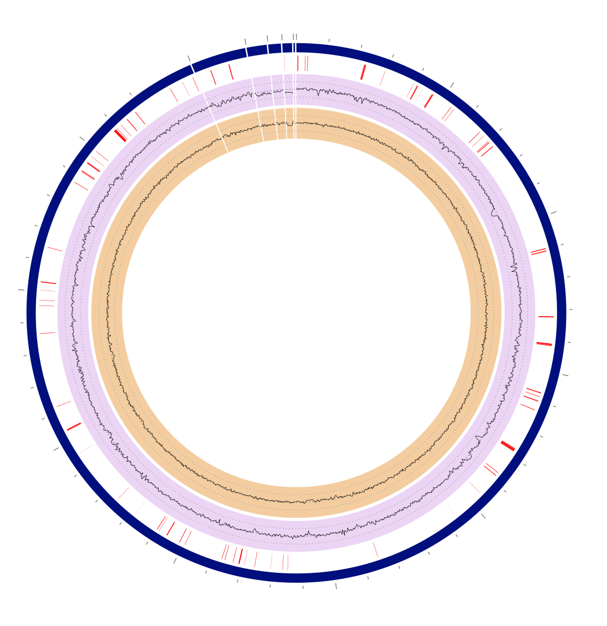
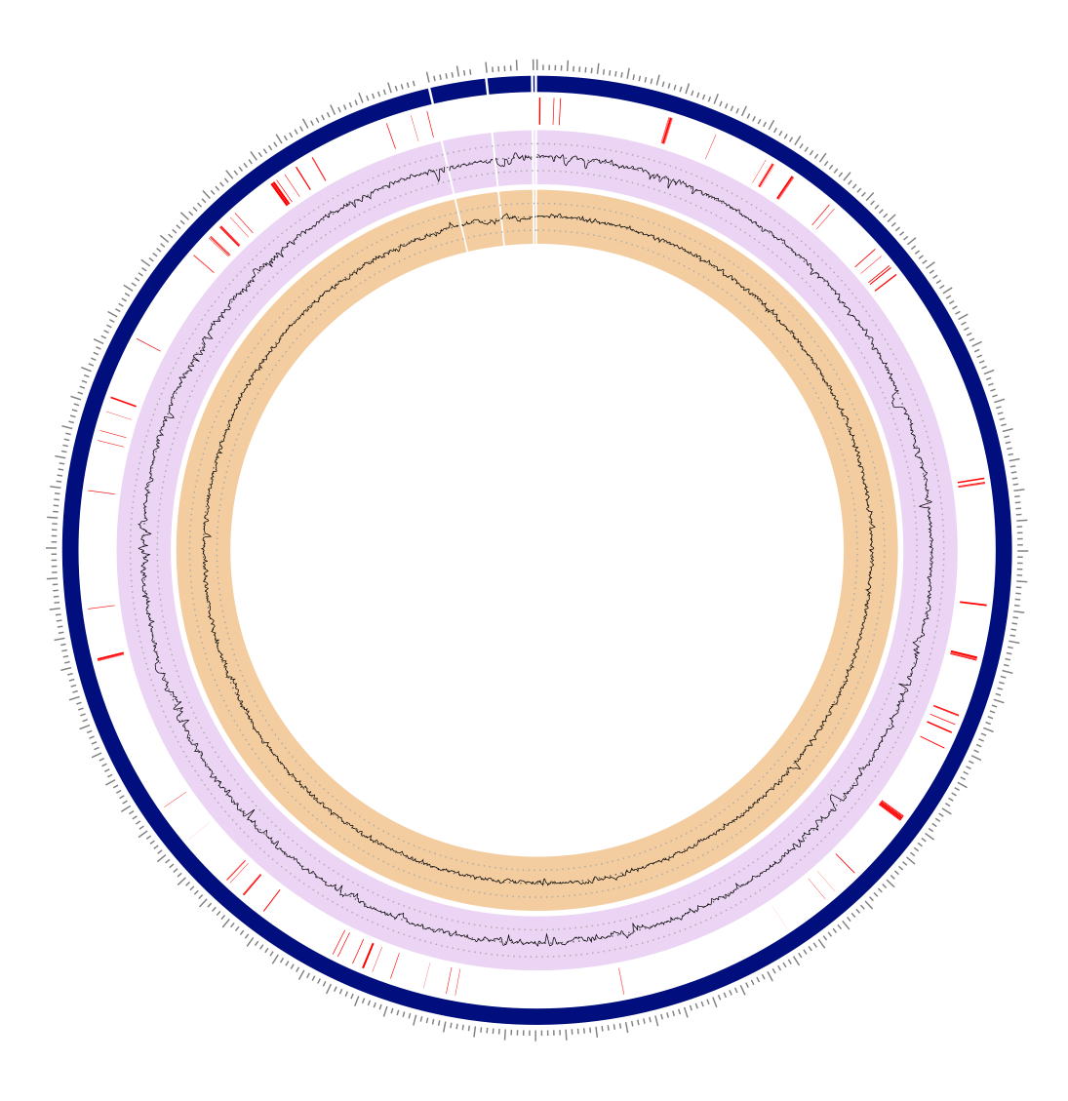
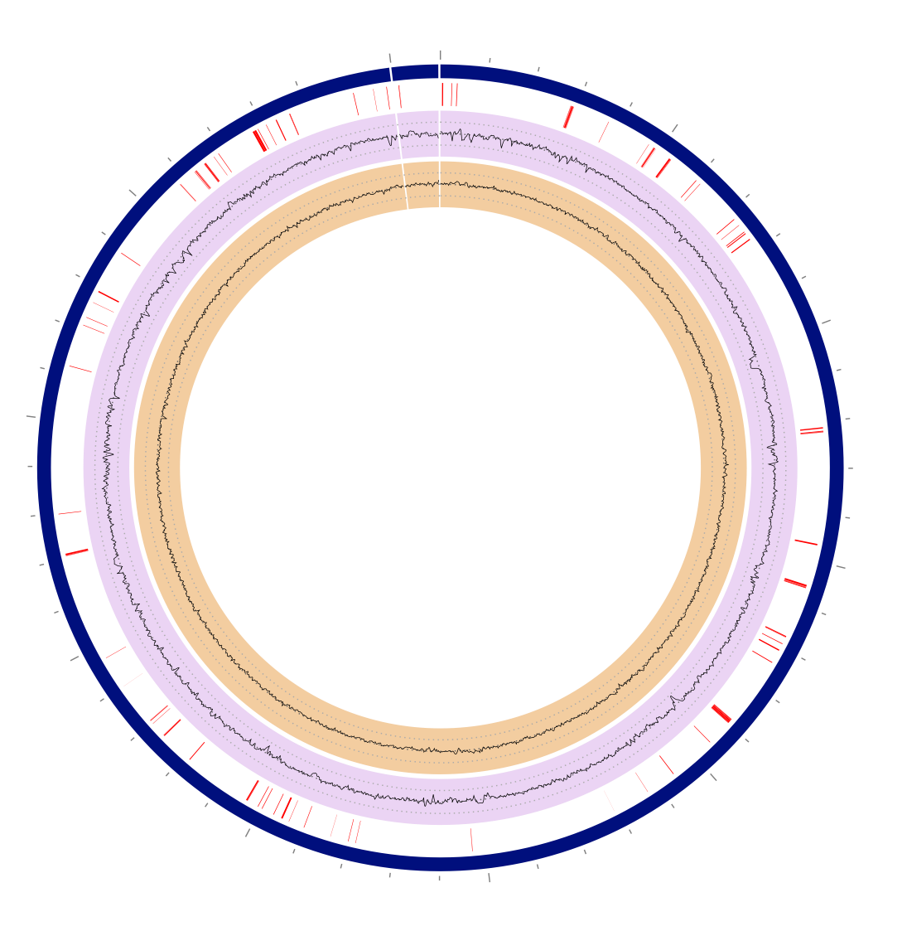
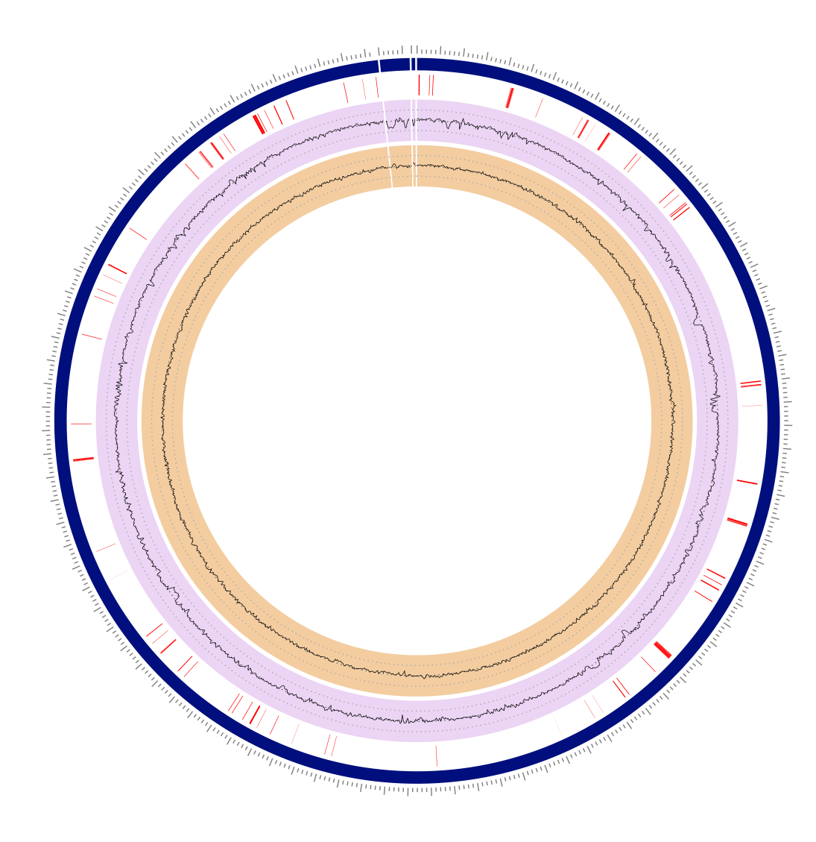
Samples from pork plants contain plasmids with ARG
Plasmids
Plasmids
Plasmids
Plasmid
Plasmids
Site 1 - #1
Site 1 - #2
Site 5 - #1
Site 9 - #1
Site 9 - #2
Macrolide efflux
Catalase peroxidase (aminoglycoside related)
Multi-drug resistance
Beta-lactamase
Aminoglycoside resistance
Tetracycline efflux
Macrolide efflux
Catalase peroxidase (aminoglycoside related)
Multi-drug resistance
Beta-lactamase
Beta-lactam antibiotics: penicillins, cephalosporins, cephamycins, monobactams, carbapenems (ertapenem), and others

