Slide 1

Measuring IRB Effectiveness through Post-Approval Compliance Monitoring
Rachel Lally, MPH, CIP
Assistant Vice President for Research
Office for Research Protections, Penn State

Slide 2
What does IRB effectiveness mean?
Not efficiency
Maybe consistency
Definitely protecting human subjects

Slide 3
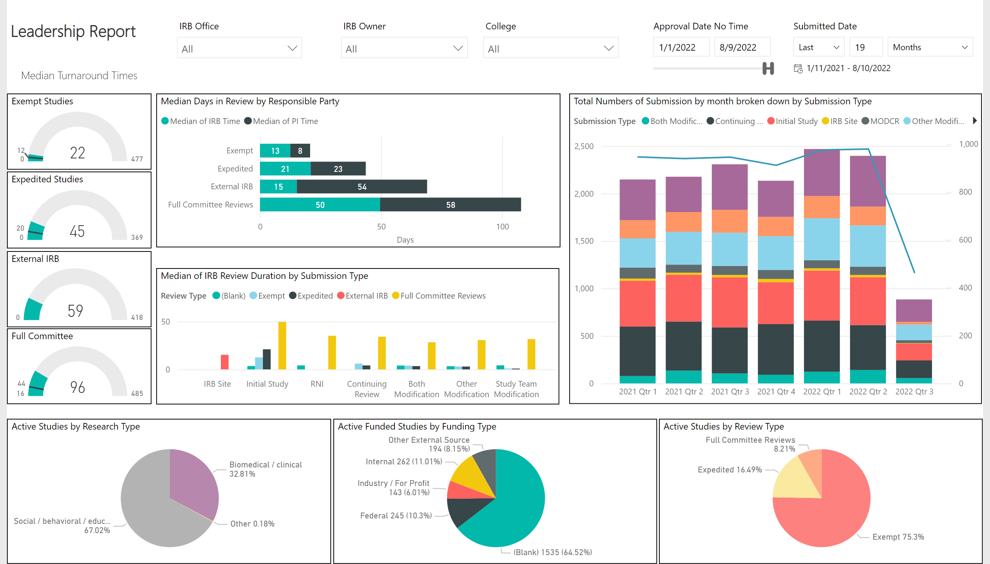
Post Approval Monitoring of Turnaround Time
Screenshot of an example dashboard of turnaround time data for the 2021 Leadership Report. Slides describes Median Turnaround Times for Exempt, Expedited, External, and Full Committee review study. Slide also details median days in review by responsible party and submission type, the total numbers of submission by month broken down by submission type, as well as active studies by research, funding, and review type.
Goal was to reduce turnaround times from 92 to 69, which was not met. IRB time was specifically reduced by 45%.
2022 Year to date: Clinical Trials submitted after IRB Transition (1/1/2021)
N=63
Increased
Goal: Reduce TAT from 92 to 69 (25%)
Overall Goal: Not met; however, IRB time specifically reduced 45%

Slide 4
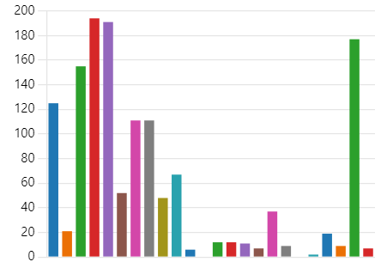

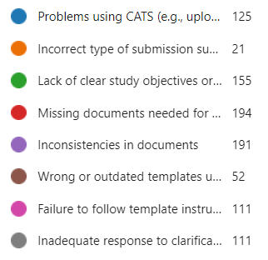


Post approval Monitoring of Analyst Perspective
    Why is approval being delayed?
    Where can education and outreach be more effective?
    What other data do we need to inform next steps?
*Not complete data

Slide 5
Post Approval Monitoring of Analyst Execution
Chart showing the number of submissions reviewed (light blue), number of submissions with findings (dark blue), and number of findings (gray line) for the HRPP Internal QA Program. Data ranges from May 2022 to December 2022, January 2023 to June 2023, July 2023 to December 2023, and January 2024 to June 2024.

Slide 6
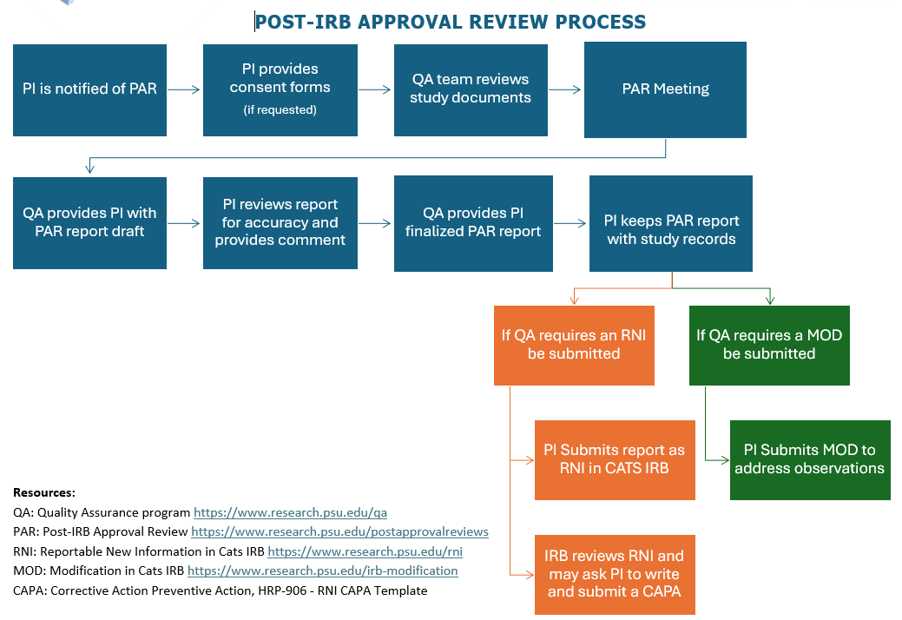
Post Approval Monitoring of Active Protocols
Flowchart steps: PI is notified of PAR, PI provides consent forms if requested, QA team reviews study documents, PAR meeting, QA provides PI with PAR report draft, PI reviews report for accuracy and provides comment, QA provides PI finalized PAR report, PI keeps PAR report with study records. If QA requires an RNI be submitted, PI submits report as RNI in CATS IRB, IRB reviews RNI and may PI to write and submit a CAPA. PI keeps PAR report with study records, if QA requires a MOD be submitted, PI submits MOD to address observations.
Post-IRB Approval Review Process.
The diagram shows the Post-IRB approval process: if PI is notified of PAR, then the PI provides consent forms (if required), the QA team reviews study documents, next is the PAR Meeting, then the QA provides PI with PAR report draft, the PI reviews the report for accuracy and proves comment, after the QA proves PI finalized PAR report, and finally, the PI keeps PAR report with study records. From there, it can continue two ways: If QA requires RNI to be submitted, PI submits reports as RNI in CATS IRB, and IRB reviews RNI and may ask PI to write and submit a CAPA. The other option is: If QA requires a MOD be submitted and the PI submits MOD to address observations.
If QA requires an RNI be submitted
PI Submits report as RNI in CATS IRB
Resources:
QA Quality Assurance Program: http://www.research.psu.qa
PAR: Post-IRB Approval Review: http://www.research.psu.edu/postapprovalreviews
RNI: Reportable New Information in Cats IRB: http://research.psu.edu/rnl
MOD: Modification in CATS IRB: http://www.research.psu.edu/irb-modification
CAPA Corrective Action Preventive Action: HRP-906-RNI CAPA Template
IRB reviews RNI and may ask PI to write and submit a CAPA

Slide 7
Post IRB Approval/Pre-Protocol Execution Monitoring
NEW SERVICE!
Proactive Audits for Continued Training (PACTS)
Prior to participant enrollment
Educational and preventative
The QA team will give guidance on best practices for:
  Recruitment
  Consent
  Data management
  Modifications
  How to handle unexpected events/reportable information
  Study closure
NOTE: There are speaker's comments located in the slide notes.
Notes:
Proactive Audits for Continued Training (PACTs) are an opportunity for the study team and investigators to meet with the Quality Assurance team to successfully implement the study procedures as approved by the IRB before participant enrollment. The Quality Assurance team tries to provide constructive, helpful feedback on study procedures to facilitate a smooth transition from study approval to study implementation, as well as to address common pitfalls the QA team finds during routine audits.

Slide 8

Can Post Approval Monitoring Measure IRB Effectiveness?
Probably – but resources are required to do it well.

Slide 9
Cumulative Total of Regulations and Policies Adopted, and/or Substantially Modified and Changes in Interpretation of Regulations or Business Practices Affecting Federal Research Since 1981
NOTE: There are speaker's comments located in the slide notes.
COGR: Aggregated Regulatory Requirements Impacting Federally Funded Research Since 1991, Figure 1
Notes:
“It is important to note that many of the requirements listed below have never been assessed for their effectiveness.“
Source: COGR: Aggregated Regulatory Requirements Impacting Federally Funded Research Since 1991
https://www.cogr.edu/sites/default/files/RegChangesSince1991_July%202024%20Clean%208-12-24.pdf
Figure citation: Anderson G, Moris F; National Center for Science and Engineering Statistics (NCSES). 2023. Federally Funded R&D Declines as a Share of GDP and Total R&D. NSF 23-339. Alexandria, VA: National Science Foundation. Available at https://ncses.nsf.gov/pubs/nsf23339/.

Slide 10
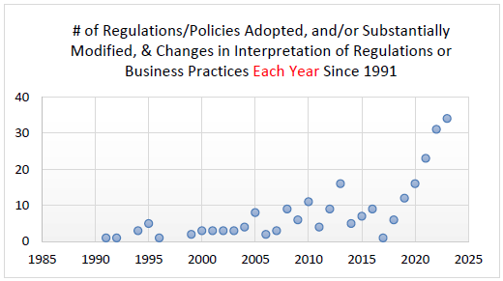
Number of Regulations/Policies Adopted, and/or Substantially Modified, and Changes in Interpretation of Regulations or Business Practices Each Year Since 1991.
Chart representing the number of regulations/policies adopted and/or substantially modified, and changes in interpretation of regulations or business practices generally trending upwards each year since 1991. Speaker comments and source URL can be found in slide notes.
Each Year
NOTE: There are speaker's comments located in the slide notes.
COGR: Aggregated Regulatory Requirements Impacting Federally Funded Research Since 1991, Figure 2
Notes:
Source: COGR: Aggregated Regulatory Requirements Impacting Federally Funded Research Since 1991
https://www.cogr.edu/sites/default/files/RegChangesSince1991_July%202024%20Clean%208-12-24.pdf
Footnote: While some regulations and business practices may have been reduced, superseded, or eliminated over the years, these graphs represent a cumulative total (Figure 1) and yearly total (Figure 2) of requirements that have required some level of analysis, response, implementation and/or oversight from institutions and higher education associations since 1991. These graphs are not meant to represent an exhaustive list of regulations and policies that institutions are currently required to comply with, and some institutions may not be required to comply with all requirements on this list.

Slide 11




Conclusions
Post Approval Monitoring may help assess IRB Effectiveness
Different stakeholders have different perspectives
Nuanced data can help inform the process
Resources are needed to effectively measure effectiveness

