Slide 1
CJR Data Portal
https://portal.cms.gov/wps/portal/unauthportal/home/
CJR UPLOAD FILES FUNCTIONALITY
SCREEN SHOTS
For issues accessing the CJR Data Portal please
Contact the CJR Support Team at
CJRSupport@cms.hhs.gov or 1-844-711-CMMI (2664), Option 1.

Slide 2
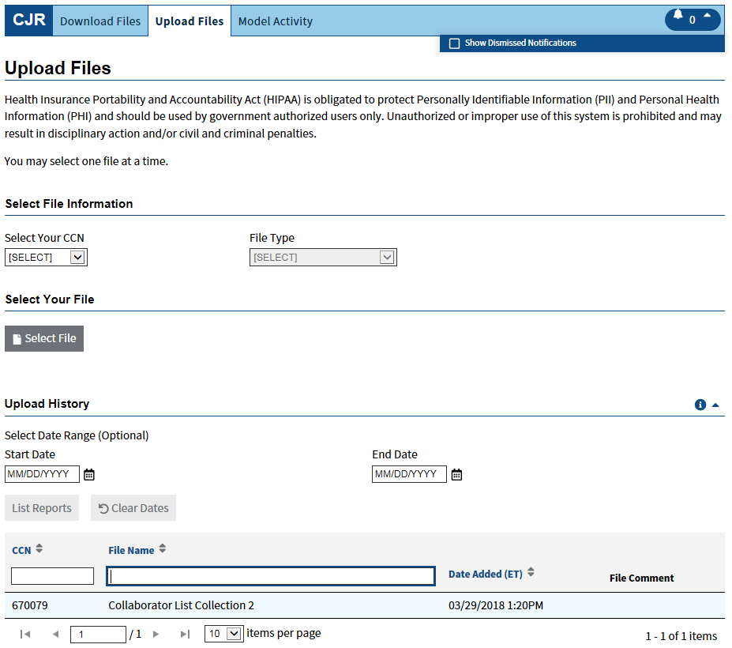
This is the default page when the Upload Files tab is selected.
The Upload History table will display the records that have previously been uploaded for your CCN.

Slide 3
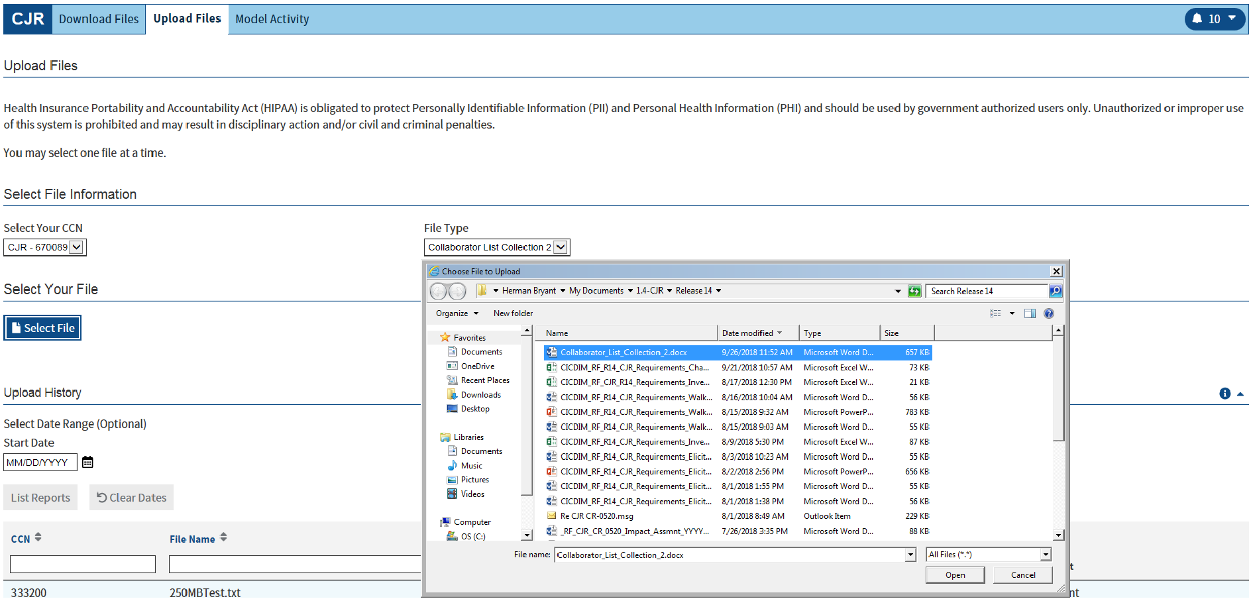
Use the Select Your CCN and File Type drop down menus to select your file information.
File Type must be Collaborator List Collection 2 ( The File Name cannot include any spaces)
Then click the Select File button to begin the upload process of the excel document.
A modal window will display, which will allow you to select a supporting document from your local directory.

Slide 4
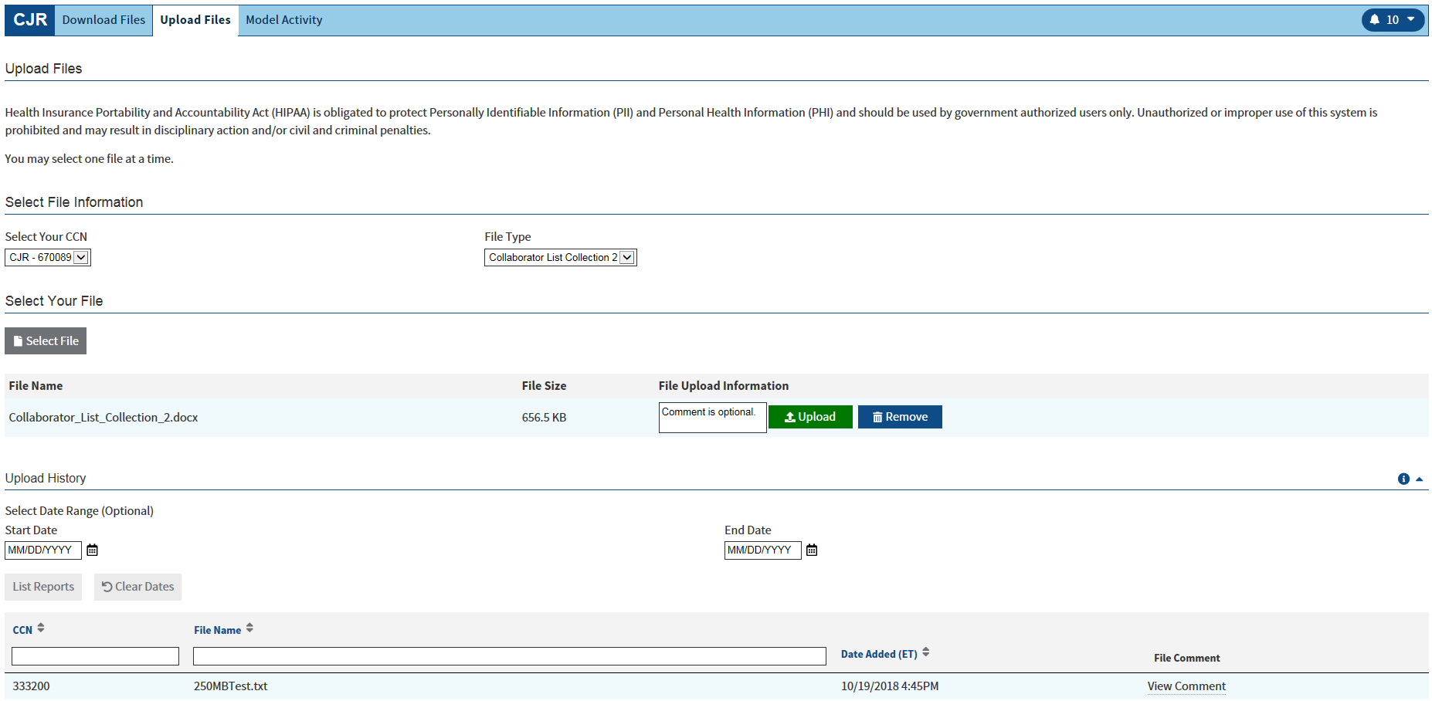
You have the option to enter a comment in the File Upload Information textbox.
If a comment is entered, it will be viewable in the Upload History table.
Select Upload to add the supporting document to the Upload History table.
Select Remove to clear the selected supporting document.

Slide 5
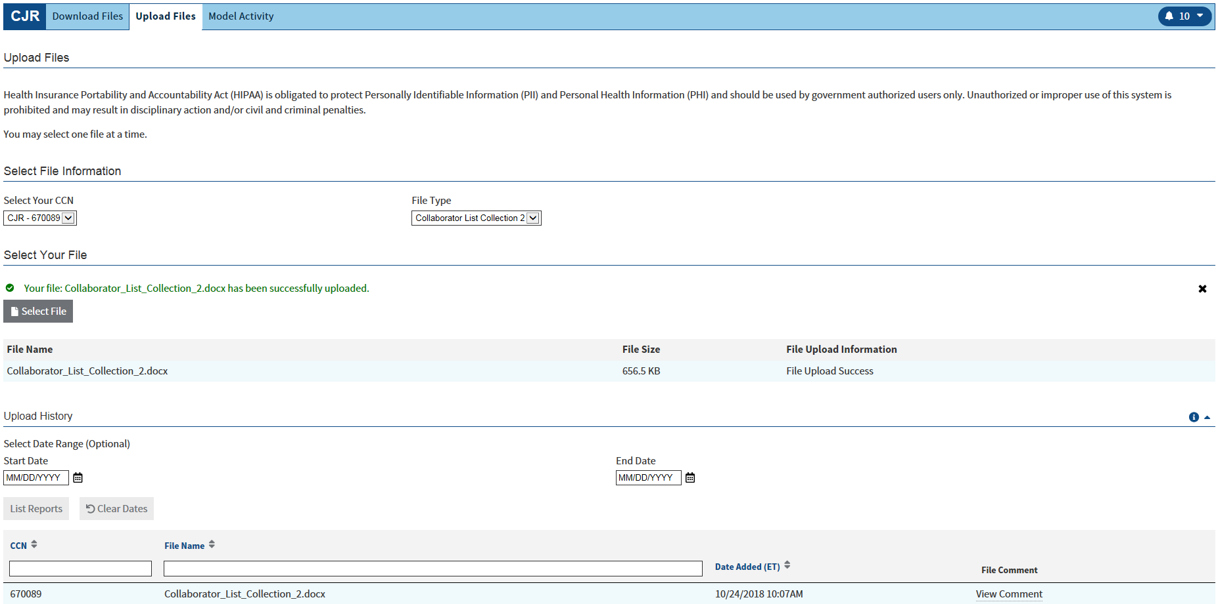
After the file is successfully uploaded, a confirmation message will display.
Select the Close icon (X) to close the confirmation message.

Slide 6
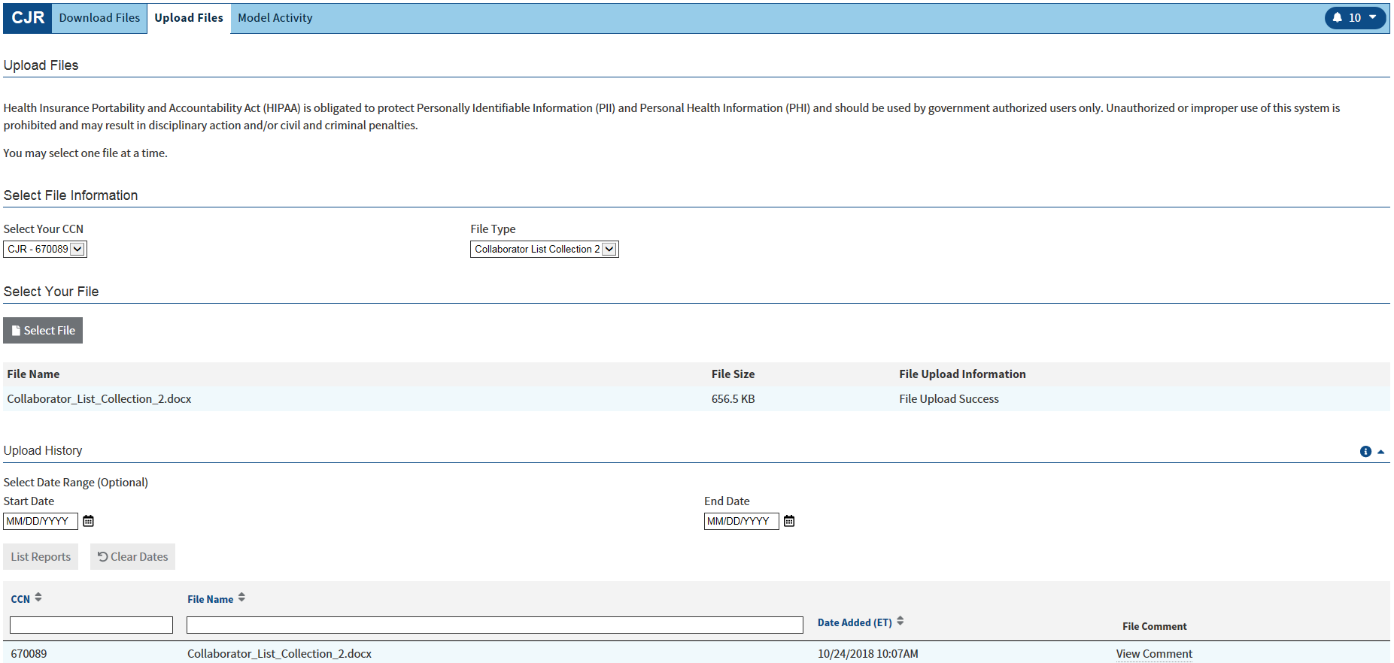
Once the Upload Files screen is refreshed, the uploaded supporting document will display in the Upload History table.

Slide 7
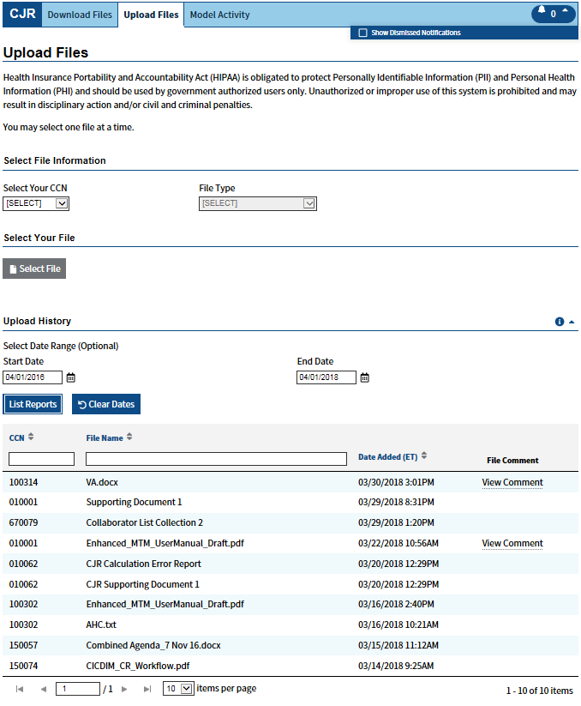
You may filter the Upload History table by entering both the Start Date and End Date in the Select Date Range area.
After entering the dates, select List Reports to display the filtered table.
To filter by CCN, enter the CCN into the CCN text box.
To filter by File Name, enter the File Name in to the File Name text box.

Slide 8
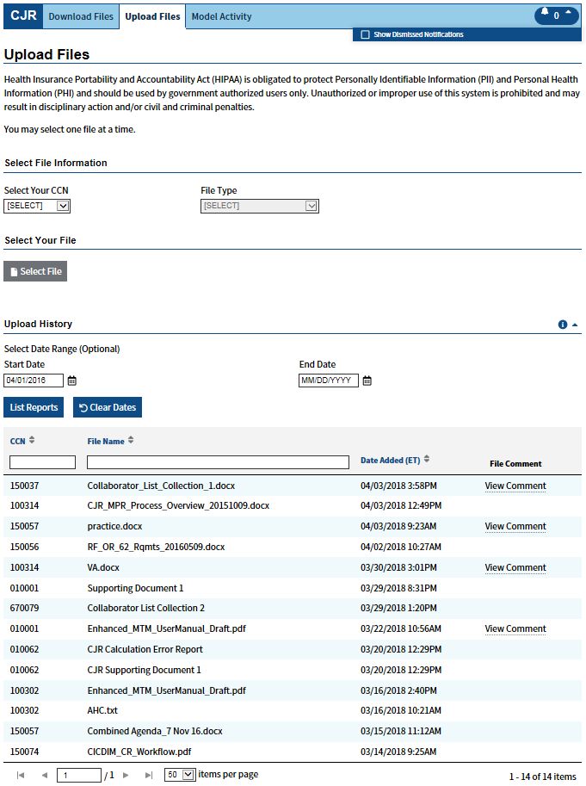
The Upload History table also can be filtered using a single date. To do this, enter a Start Date or End Date.
If only a Start Date is entered, all supporting documents uploaded from that date to present will be displayed.
If only an End Date is entered, all supporting documents uploaded from the start of the model through the entered date will be displayed.

